Slide 1
Chapter 11 I/O Management and Disk Scheduling
Operating Systems: Internals and Design Principles
Seventh Edition By William Stallings
Notes:
“Operating Systems: Internal and Design Principles”, 7/e, by William Stallings, Chapter 11 “I/O Management and Disk Scheduling”.
‹#›

Slide 2

Operating Systems: Internals and Design Principles
An artifact can be thought of as a meeting point—an “interface” in today’s terms between an “inner” environment, the substance and organization of the artifact itself, and an “outer” environment, the surroundings in which it operates. If the inner environment is appropriate to the outer environment, or vice versa, the artifact will serve its intended purpose.
— THE SCIENCES OF THE ARTIFICIAL,
Herbert Simon
Notes:
Perhaps the messiest aspect of operating system design is input/output. Because
there is such a wide variety of devices and applications of those devices, it is difficult
to develop a general, consistent solution.
We begin this chapter with a brief discussion of I/O devices and the organization
of the I/O functions. These topics, which generally come within the scope of
computer architecture, set the stage for an examination of I/O from the point of view
of the operating system.
The next section examines operating system design issues, including design
objectives, and the way in which the I/O function can be structured. Then I/O
buffering is examined; one of the basic I/O services provided by the operating
system is a buffering function, which improves overall performance.
The next sections of the chapter are devoted to magnetic disk I/O. In contemporary
systems, this form of I/O is the most important and is key to the performance as perceived
by the user. We begin by developing a model of disk I/O performance and then
examine several techniques that can be used to enhance performance.
Appendix J summarizes characteristics of secondary storage devices, including
magnetic disk and optical memory.
‹#›

Slide 3
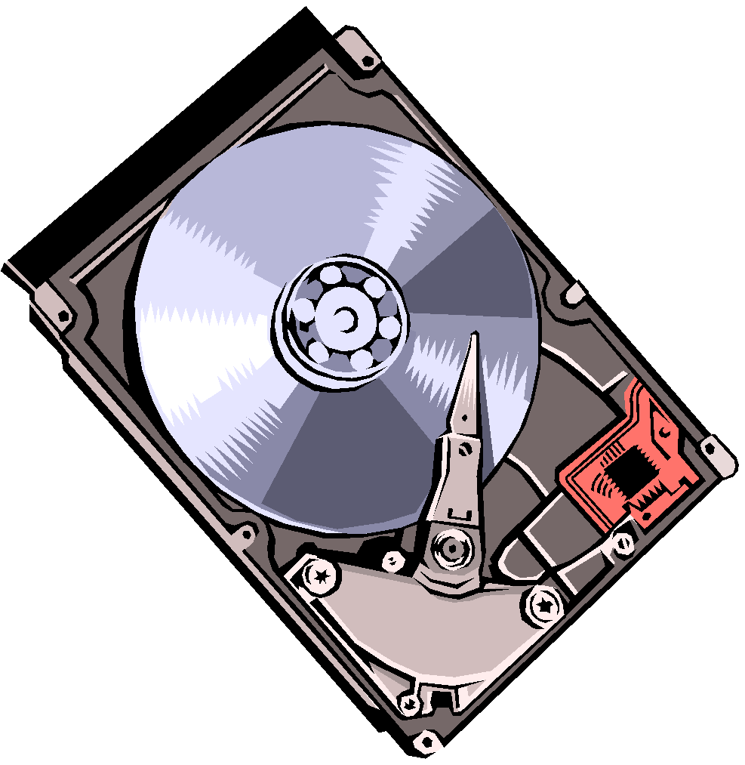
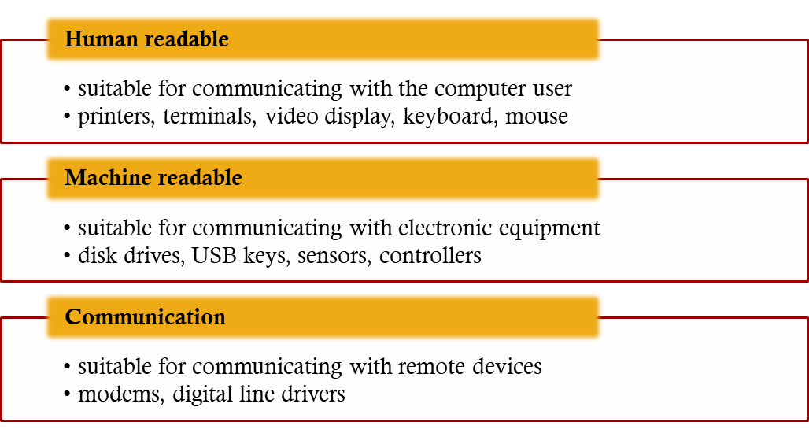
Categories of I/O Devices
External devices that engage in I/O with computer systems can be grouped into three categories:
Notes:
As was mentioned in Chapter 1 , external devices that engage in I/O with computer
systems can be roughly grouped into three categories:
• Human readable: Suitable for communicating with the computer user.
Examples include printers and terminals, the latter consisting of video display,
keyboard, and perhaps other devices such as a mouse.
Machine readable: Suitable for communicating with electronic equipment.
Examples are disk drives, USB keys, sensors, controllers, and actuators.
• Communication: Suitable for communicating with remote devices. Examples
are digital line drivers and modems.
‹#›

Slide 4
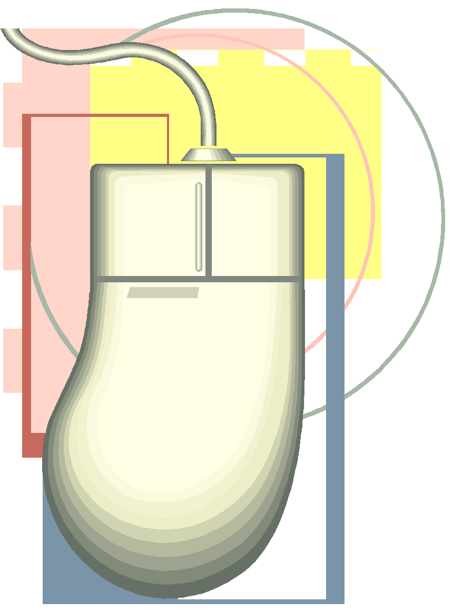
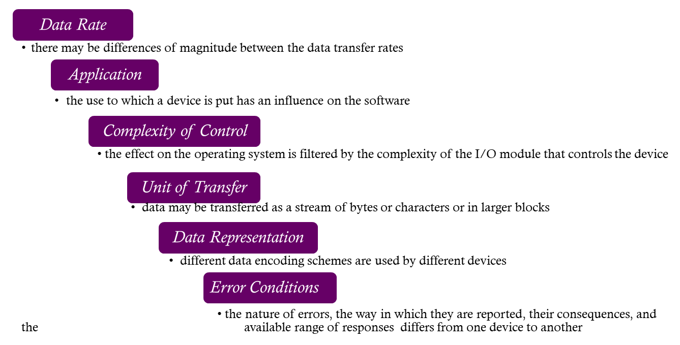
Differences in I/O Devices
Devices differ in a number of areas:
Notes:
There are great differences across classes and even substantial differences
within each class. Among the key differences are the following:
• Data rate: There may be differences of several orders of magnitude between
the data transfer rates. Figure 11.1 gives some examples.
• Application: The use to which a device is put has an influence on the software
and policies in the operating system and supporting utilities. For example, a
disk used for files requires the support of file management software. A disk
used as a backing store for pages in a virtual memory scheme depends on the
use of virtual memory hardware and software. Furthermore, these applications
have an impact on disk scheduling algorithms (discussed later in this
chapter). As another example, a terminal may be used by an ordinary user or a
system administrator. These uses imply different privilege levels and perhaps
different priorities in the operating system.
• Complexity of control: A printer requires a relatively simple control interface.
A disk is much more complex. The effect of these differences on the operating
system is filtered to some extent by the complexity of the I/O module that
controls the device, as discussed in the next section.
Unit of transfer: Data may be transferred as a stream of bytes or characters
(e.g., terminal I/O) or in larger blocks (e.g., disk I/O).
• Data representation: Different data encoding schemes are used by different
devices, including differences in character code and parity conventions.
• Error conditions: The nature of errors, the way in which they are reported,
their consequences, and the available range of responses differ widely from
one device to another.
This diversity makes a uniform and consistent approach to I/O, both from the
point of view of the operating system and from the point of view of user processes,
difficult to achieve.
‹#›

Slide 5

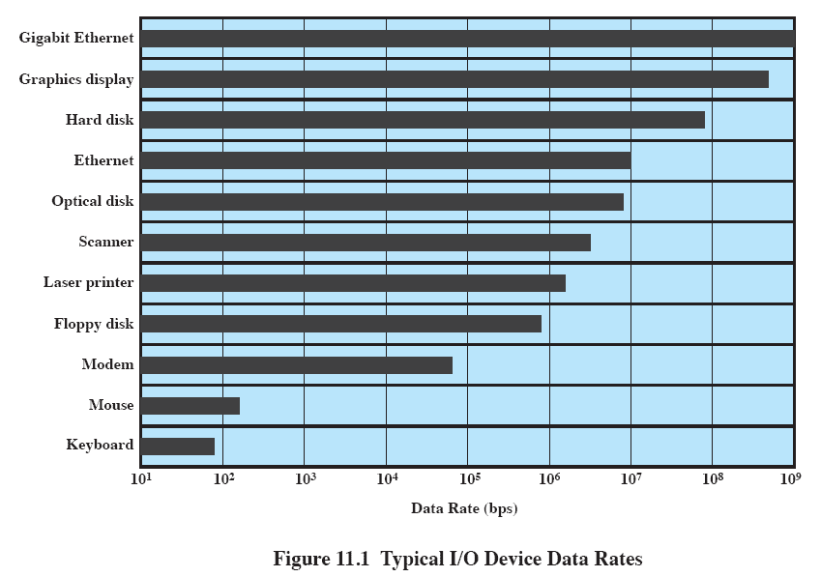
Data Rates
Notes:
There may be differences of several orders of magnitude between the data transfer rates.
Figure 11.1 gives some examples.
‹#›

Slide 6
Organization of the I/O Function
Three techniques for performing I/O are:
Programmed I/O
the processor issues an I/O command on behalf of a process to an I/O module; that process then busy waits for the operation to be completed before proceeding
Interrupt-driven I/O
the processor issues an I/O command on behalf of a process
if non-blocking – processor continues to execute instructions from the process that issued the I/O command
if blocking – the next instruction the processor executes is from the OS, which will put the current process in a blocked state and schedule another process
Direct Memory Access (DMA)
a DMA module controls the exchange of data between main memory and an I/O module
Notes:
Appendix C summarizes three techniques for performing I/O:
• Programmed I/O : The processor issues an I/O command, on behalf of a process,
to an I/O module; that process then busy waits for the operation to be completed
before proceeding.
• Interrupt-driven I/O : The processor issues an I/O command on behalf of
a process. There are then two possibilities. If the I/O instruction from the
process is nonblocking, then the processor continues to execute instructions
from the process that issued the I/O command. If the I/O instruction
is blocking, then the next instruction that the processor executes is from
the OS, which will put the current process in a blocked state and schedule
another process.
• Direct memory access (DMA) : A DMA module controls the exchange of data
between main memory and an I/O module. The processor sends a request for
the transfer of a block of data to the DMA module and is interrupted only
after the entire block has been transferred.
‹#›

Slide 7

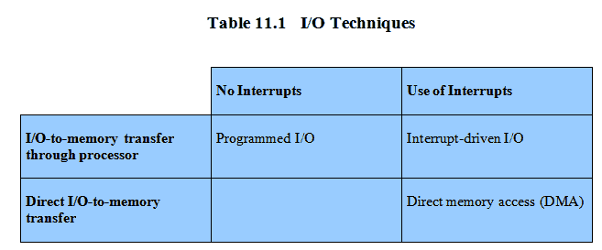
Techniques for Performing I/O
Notes:
Table 11.1 indicates the relationship among these three techniques. In most
computer systems, DMA is the dominant form of transfer that must be supported
by the operating system.
‹#›

Slide 8
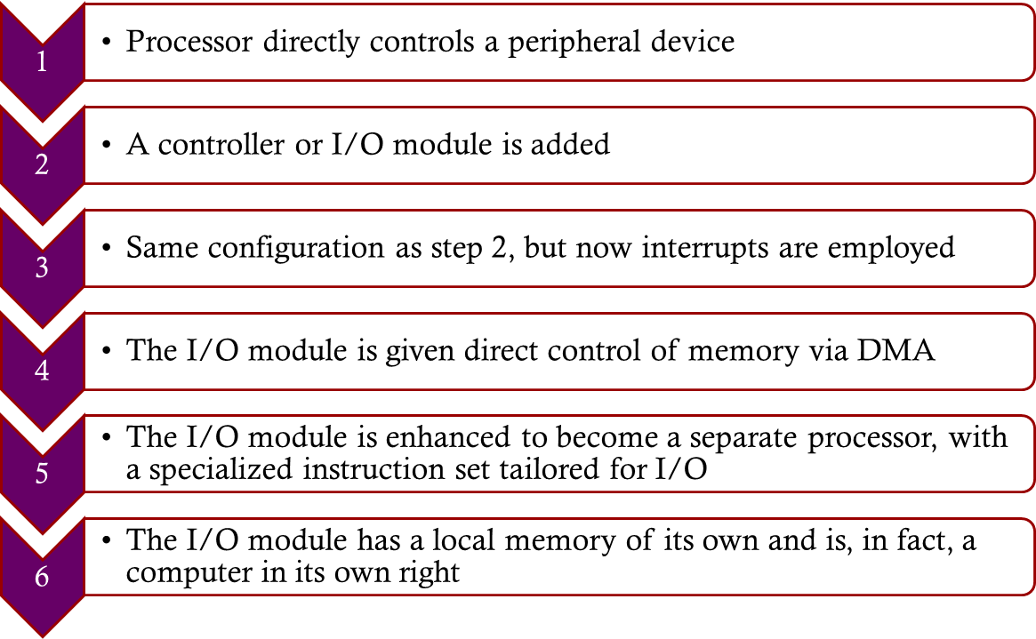

Evolution of the I/O Function
Notes:
As computer systems have evolved, there has been a pattern of increasing
complexity and sophistication of individual components. Nowhere is this more
evident than in the I/O function. The evolutionary steps can be summarized as
Follows:
1. The processor directly controls a peripheral device. This is seen in simple
microprocessor-controlled devices.
2. A controller or I/O module is added. The processor uses programmed I/O
without interrupts. With this step, the processor becomes somewhat divorced
from the specific details of external device interfaces.
3. The same configuration as step 2 is used, but now interrupts are employed. The
processor need not spend time waiting for an I/O operation to be performed,
thus increasing efficiency.
4. The I/O module is given direct control of memory via DMA. It can now move
a block of data to or from memory without involving the processor, except at
the beginning and end of the transfer.
5. The I/O module is enhanced to become a separate processor, with a
specialized instruction set tailored for I/O. The central processing unit
(CPU) directs the I/O processor to execute an I/O program in main
memory. The I/O processor fetches and executes these instructions without
processor intervention. This allows the processor to specify a sequence of
I/O activities and to be interrupted only when the entire sequence has been
performed.
6. The I/O module has a local memory of its own and is, in fact, a computer
in its own right. With this architecture, a large set of I/O devices can be
controlled, with minimal processor involvement. A common use for such an
architecture has been to control communications with interactive terminals.
The I/O processor takes care of most of the tasks involved in controlling the
terminals.
As one proceeds along this evolutionary path, more and more of the I/O
function is performed without processor involvement. The central processor is
increasingly relieved of I/O-related tasks, improving performance. With the last
two steps (5 and 6), a major change occurs with the introduction of the concept of
an I/O module capable of executing a program.
A note about terminology: For all of the modules described in steps 4
through 6, the term direct memory access is appropriate, because all of these
types involve direct control of main memory by the I/O module. Also, the I/O
module in step 5 is often referred to as an I/O channel , and that in step 6 as an
I/O processor ; however, each term is, on occasion, applied to both situations. In
the latter part of this section, we will use the term I/O channel to refer to both
types of I/O modules.
‹#›

Slide 9
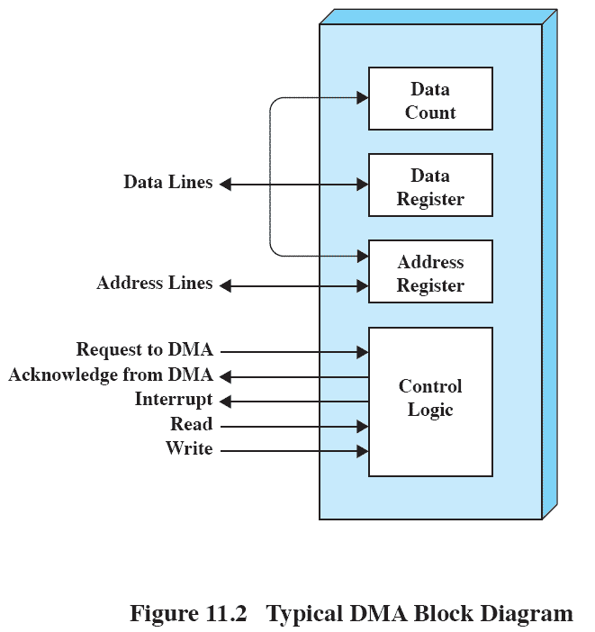

Direct Memory Access
Notes:
Figure 11.2 indicates, in general terms, the DMA logic. The DMA unit is capable of
mimicking the processor and, indeed, of taking over control of the system bus just
like a processor. It needs to do this to transfer data to and from memory over the
system bus.
The DMA technique works as follows. When the processor wishes to read or
write a block of data, it issues a command to the DMA module by sending to the
DMA module the following information:
• Whether a read or write is requested, using the read or write control line
between the processor and the DMA module
• The address of the I/O device involved, communicated on the data lines
• The starting location in memory to read from or write to, communicated on
the data lines and stored by the DMA module in its address register
• The number of words to be read or written, again communicated via the data
lines and stored in the data count register
The processor then continues with other work. It has delegated this I/O operation
to the DMA module. The DMA module transfers the entire block of data, one word
at a time, directly to or from memory, without going through the processor. When the
transfer is complete, the DMA module sends an interrupt signal to the processor. Thus,
the processor is involved only at the beginning and end of the transfer (Figure C.4c).
‹#›

Slide 10
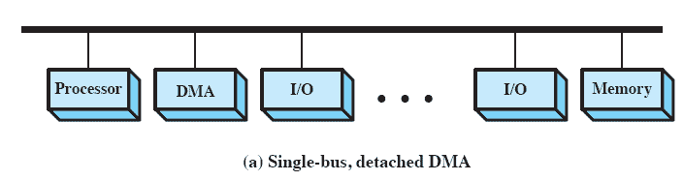
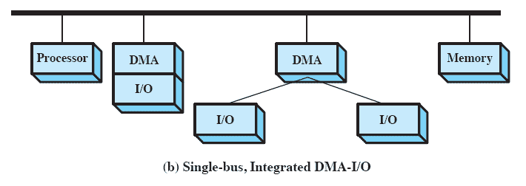
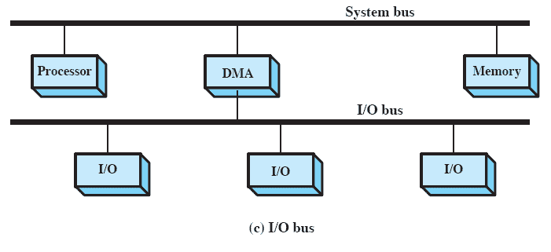
Alternative
DMA
Configurations
Notes:
The DMA mechanism can be configured in a variety of ways. Some possibilities
are shown in Figure 11.3 . In the first example, all modules share the same
system bus. The DMA module, acting as a surrogate processor, uses programmed
I/O to exchange data between memory and an I/O module through the DMA module.
This configuration, while it may be inexpensive, is clearly inefficient: As with
processor-controlled programmed I/O, each transfer of a word consumes two bus
cycles (transfer request followed by transfer).
The number of required bus cycles can be cut substantially by integrating the
DMA and I/O functions. As Figure 11.3b indicates, this means that there is a path
between the DMA module and one or more I/O modules that does not include the
system bus. The DMA logic may actually be a part of an I/O module, or it may be a
separate module that controls one or more I/O modules. This concept can be taken
one step further by connecting I/O modules to the DMA module using an I/O bus
( Figure 11.3c ). This reduces the number of I/O interfaces in the DMA module
to one and provides for an easily expandable configuration. In all of these cases
( Figure 11.3b and 11.3c ), the system bus that the DMA module shares with the
processor and main memory is used by the DMA module only to exchange data
with memory and to exchange control signals with the processor. The exchange of
data between the DMA and I/O modules takes place off the system bus.
‹#›

Slide 11
Design Objectives
Efficiency
Generality
Major effort in I/O design
Important because I/O operations often form a bottleneck
Most I/O devices are extremely slow compared with main memory and the processor
The area that has received the most attention is disk I/O
Desirable to handle all devices in a uniform manner
Applies to the way processes view I/O devices and the way the operating system manages I/O devices and operations
Diversity of devices makes it difficult to achieve true generality
Use a hierarchical, modular approach to the design of the I/O function
Notes:
Two objectives are paramount in designing the I/O facility: efficiency and generality.
Efficiency is important because I/O operations often form a bottleneck in a
computing system. Looking again at Figure 11.1 , we see that most I/O devices are
extremely slow compared with main memory and the processor. One way to tackle
this problem is multiprogramming, which, as we have seen, allows some processes
to be waiting on I/O operations while another process is executing. However, even
with the vast size of main memory in today’s machines, it will still often be the case
that I/O is not keeping up with the activities of the processor. Swapping is used to
bring in additional ready processes to keep the processor busy, but this in itself is an
I/O operation. Thus, a major effort in I/O design has been schemes for improving
the efficiency of the I/O. The area that has received the most attention, because of
its importance, is disk I/O, and much of this chapter will be devoted to a study of
disk I/O efficiency.
The other major objective is generality . In the interests of simplicity and freedom
from error, it is desirable to handle all devices in a uniform manner. This
statement applies both to the way in which processes view I/O devices and the way
in which the operating system manages I/O devices and operations. Because of the
diversity of device characteristics, it is difficult in practice to achieve true generality.
What can be done is to use a hierarchical, modular approach to the design of
the I/O function. This approach hides most of the details of device I/O in lower level
routines so that user processes and upper levels of the operating system see
devices in terms of general functions, such as read, write, open, close, lock, and
unlock. We turn now to a discussion of this approach.
‹#›

Slide 12

Hierarchical Design
Functions of the operating system should be separated according to their complexity, their characteristic time scale, and their level of abstraction
Leads to an organization of the operating system into a series of layers
Each layer performs a related subset of the functions required of the operating system
Layers should be defined so that changes in one layer do not require changes in other layers
Notes:
In Chapter 2 , in the discussion of system structure, we emphasized the hierarchical
nature of modern operating systems. The hierarchical philosophy is that the functions
of the operating system should be separated according to their complexity,
their characteristic time scale, and their level of abstraction. Following this approach
leads to an organization of the operating system into a series of layers. Each layer
performs a related subset of the functions required of the operating system. It relies
on the next lower layer to perform more primitive functions and to conceal the
details of those functions. It provides services to the next higher layer. Ideally, the
layers should be defined so that changes in one layer do not require changes in other
layers. Thus we have decomposed one problem into a number of more manageable
subproblems.
In general, lower layers deal with a far shorter time scale. Some parts of the
OS must interact directly with the computer hardware, where events can have a
time scale as brief as a few billionths of a second. At the other end of the spectrum,
parts of the operating system communicate with the user, who issues commands at a
much more leisurely pace, perhaps one every few seconds. The use of a set of layers
conforms nicely to this environment.
‹#›

Slide 13
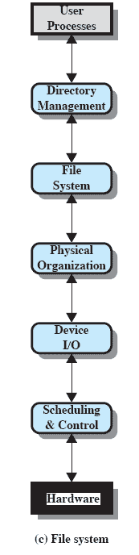
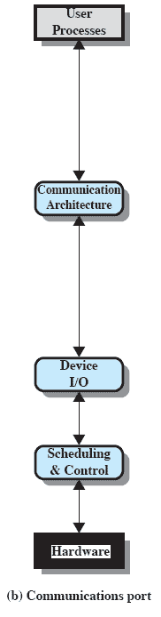
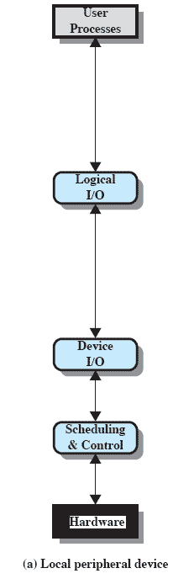

A Model of I/O Organization
Notes:
Applying this philosophy specifically to the I/O facility leads to the type
of organization suggested by Figure 11.4 . The details of the organization will
depend on the type of device and the application. The three most important
logical structures are presented in the figure. Of course, a particular operating
system may not conform exactly to these structures. However, the general
principles are valid, and most operating systems approach I/O in approximately
this way.
Let us consider the simplest case first, that of a local peripheral device that
communicates in a simple fashion, such as a stream of bytes or records ( Figure 11.4a ).
The following layers are involved:
• Logical I/O : The logical I/O module deals with the device as a logical resource
and is not concerned with the details of actually controlling the device. The
logical I/O module is concerned with managing general I/O functions on behalf
of user processes, allowing them to deal with the device in terms of a device
identifier and simple commands such as open, close, read, and write.
• Device I/O : The requested operations and data (buffered characters, records,
etc.) are converted into appropriate sequences of I/O instructions, channel
commands, and controller orders. Buffering techniques may be used to improve
utilization.
• Scheduling and control: The actual queuing and scheduling of I/O operations
occurs at this layer, as well as the control of the operations. Thus, interrupts
are handled at this layer and I/O status is collected and reported. This is the
layer of software that actually interacts with the I/O module and hence the
device hardware.
For a communications device, the I/O structure ( Figure 11.4b ) looks much the
same as that just described. The principal difference is that the logical I/O module is
replaced by a communications architecture, which may itself consist of a number of
layers. An example is TCP/IP, which is discussed in Chapter 17 .
Figure 11.4c shows a representative structure for managing I/O on a secondary
storage device that supports a file system. The three layers not previously discussed
are as follows:
• Directory management: At this layer, symbolic file names are converted to
identifiers that either reference the file directly or indirectly through a file
descriptor or index table. This layer is also concerned with user operations
that affect the directory of files, such as add, delete, and reorganize.
• File system: This layer deals with the logical structure of files and with the
operations that can be specified by users, such as open, close, read, and write.
Access rights are also managed at this layer.
• Physical organization: Just as virtual memory addresses must be converted
into physical main memory addresses, taking into account the segmentation
and paging structure, logical references to files and records must be converted
to physical secondary storage addresses, taking into account the physical
track and sector structure of the secondary storage device. Allocation of
secondary storage space and main storage buffers is generally treated at this
layer as well.
Because of the importance of the file system, we will spend some time, in this
chapter and the next, looking at its various components. The discussion in this chapter
focuses on the lower three layers, while the upper two layers are examined in
Chapter 12 .
‹#›

Slide 14
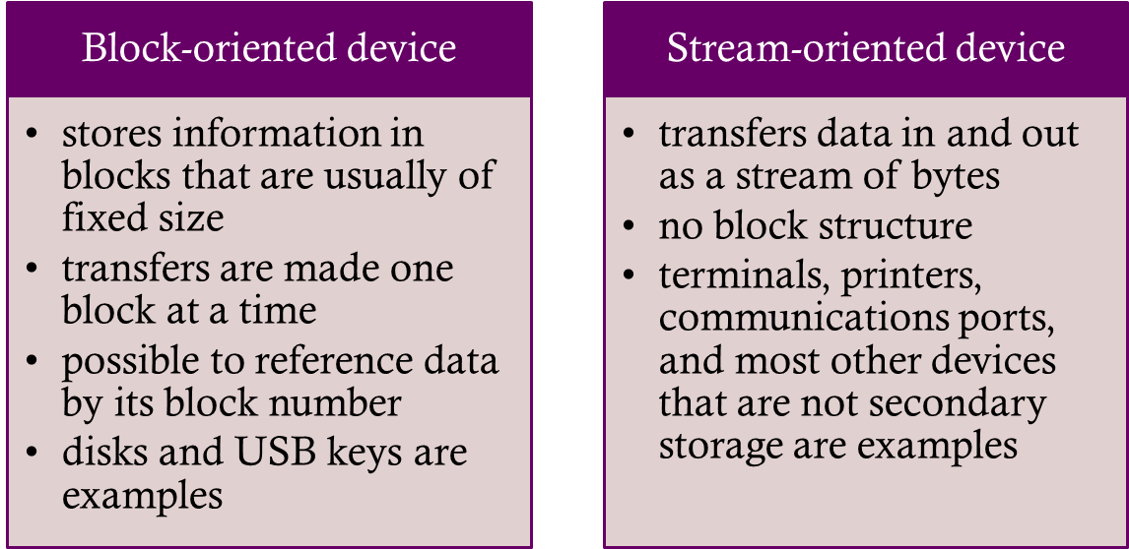
Buffering
Perform input transfers in advance of requests being made and perform output transfers some time after the request is made
Notes:
The same considerations apply to an output operation. If a block is being
transferred from a user process area directly to an I/O module, then the process is
blocked during the transfer and the process may not be swapped out.
To avoid these overheads and inefficiencies, it is sometimes convenient to
perform input transfers in advance of requests being made and to perform output
transfers some time after the request is made. This technique is known as buffering.
In this section, we look at some of the buffering schemes that are supported by
operating systems to improve the performance of the system.
In discussing the various approaches to buffering, it is sometimes important
to make a distinction between two types of I/O devices: block oriented and stream
oriented. A block-oriented device stores information in blocks that are usually of
fixed size, and transfers are made one block at a time. Generally, it is possible to
reference data by its block number. Disks and USB keys are examples of block oriented
devices. A stream-oriented device transfers data in and out as a stream of
bytes, with no block structure. Terminals, printers, communications ports, mouse
and other pointing devices, and most other devices that are not secondary storage
are stream oriented.
‹#›

Slide 15
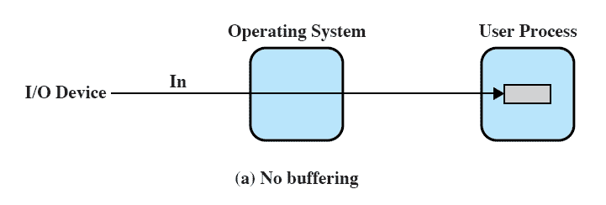
No Buffer
Without a buffer, the OS directly accesses the device when it needs
Notes:
Without a buffer, the OS directly accesses the device when it needs to.
‹#›

Slide 16
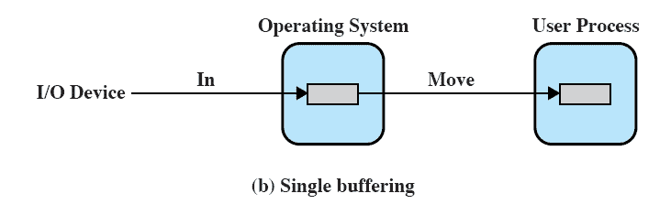
Single Buffer
Operating system assigns a buffer in main memory for an I/O request
Notes:
The simplest type of support that the operating system can provide is single buffering
( Figure 11.5b ). When a user process issues an I/O request, the OS assigns a buffer in
the system portion of main memory to the operation.
In the case of line-at-a-time I/O, the buffer can be used to hold a single line.
The user process is suspended during input, awaiting the arrival of the entire line.
For output, the user process can place a line of output in the buffer and continue
processing. It need not be suspended unless it has a second line of output to send
before the buffer is emptied from the first output operation. In the case of byte-at-a-time
I/O, the interaction between the OS and the user process follows the producer/
consumer model discussed in Chapter 5 .
‹#›

Slide 17
Block-Oriented Single Buffer
Input transfers are made to the system buffer
Reading ahead/anticipated input
is done in the expectation that the block will eventually be needed
when the transfer is complete, the process moves the block into user space and immediately requests another block
Generally provides a speedup compared to the lack of system buffering
Disadvantages:
complicates the logic in the operating system
swapping logic is also affected
Notes:
For block-oriented devices, the single buffering scheme can be described
as follows: Input transfers are made to the system buffer. When the transfer is
complete, the process moves the block into user space and immediately requests
another block. This is called reading ahead, or anticipated input; it is done in the
expectation that the block will eventually be needed. For many types of computation,
this is a reasonable assumption most of the time because data are usually
accessed sequentially. Only at the end of a sequence of processing will a block be
read in unnecessarily.
This approach will generally provide a speedup compared to the lack of system
buffering. The user process can be processing one block of data while the next block
is being read in. The OS is able to swap the process out because the input operation
is taking place in system memory rather than user process memory. This technique
does, however, complicate the logic in the operating system. The OS must keep
track of the assignment of system buffers to user processes. The swapping logic is
also affected: If the I/O operation involves the same disk that is used for swapping,
it hardly makes sense to queue disk writes to the same device for swapping the process
out. This attempt to swap the process and release main memory will itself not
begin until after the I/O operation finishes, at which time swapping the process to
disk may no longer be appropriate.
Similar considerations apply to block-oriented output. When data are being
transmitted to a device, they are first copied from the user space into the system
buffer, from which they will ultimately be written. The requesting process is now
free to continue or to be swapped as necessary.
[KNUT97] suggests a crude but informative performance comparison between
single buffering and no buffering. Suppose that T is the time required to input one
block and that C is the computation time that intervenes between input requests.
Without buffering, the execution time per block is essentially T + C . With a single
buffer, the time is max [C, T] + M , where M is the time required to move the data
from the system buffer to user memory. In most cases, execution time per block is
substantially less with a single buffer compared to no buffer.
‹#›

Slide 18


Stream-Oriented Single Buffer
Line-at-a-time operation
appropriate for scroll-mode terminals (dumb terminals)
user input is one line at a time with a carriage return signaling the end of a line
output to the terminal is similarly one line at a time
Byte-at-a-time operation
used on forms-mode terminals
when each keystroke is significant
other peripherals such as sensors and controllers
Notes:
For stream-oriented I/O, the single buffering scheme can be used in a line-at-
a-time fashion or a byte-at-a-time fashion. Line-at-a-time operation is appropriate
for scroll-mode terminals (sometimes called dumb terminals). With this form
of terminal, user input is one line at a time, with a carriage return signaling the end
of a line, and output to the terminal is similarly one line at a time. A line printer is
another example of such a device. Byte-at-a-time operation is used on forms-mode
terminals, when each keystroke is significant, and for many other peripherals, such
as sensors and controllers.
In the case of line-at-a-time I/O, the buffer can be used to hold a single line.
The user process is suspended during input, awaiting the arrival of the entire line.
For output, the user process can place a line of output in the buffer and continue
processing. It need not be suspended unless it has a second line of output to send
before the buffer is emptied from the first output operation. In the case of byte-at-atime
I/O, the interaction between the OS and the user process follows the producer/
consumer model discussed in Chapter 5 .
‹#›

Slide 19
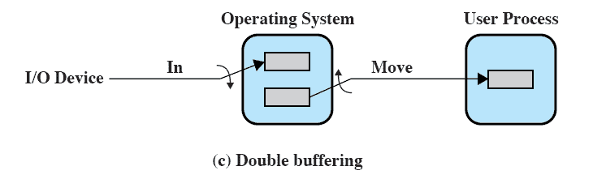
Double Buffer
Use two system buffers instead of one
A process can transfer data to or from one buffer while the operating system empties or fills the other buffer
Also known as buffer swapping
Notes:
An improvement over single buffering can be had by assigning two system buffers to
the operation ( Figure 11.5c ). A process now transfers data to (or from) one buffer
while the operating system empties (or fills) the other. This technique is known as
double buffering or buffer swapping .
For block-oriented transfer, we can roughly estimate the execution time as
max [ C , T ]. It is therefore possible to keep the block-oriented device going at full
speed if C … T . On the other hand, if C 7 T , double buffering ensures that the
process will not have to wait on I/O. In either case, an improvement over single
buffering is achieved. Again, this improvement comes at the cost of increased
complexity.
For stream-oriented input, we again are faced with the two alternative modes
of operation. For line-at-a-time I/O, the user process need not be suspended for
input or output, unless the process runs ahead of the double buffers. For byte-at-atime
operation, the double buffer offers no particular advantage over a single buffer
of twice the length. In both cases, the producer/consumer model is followed.
‹#›

Slide 20
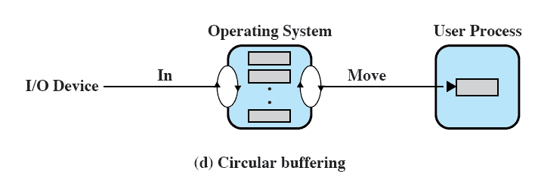
Circular Buffer
Two or more buffers are used
Each individual buffer is one unit in a circular buffer
Used when I/O operation must keep up with process
Notes:
A double-buffer scheme should smooth out the flow of data between an I/O device
and a process. If the performance of a particular process is the focus of our concern,
then we would like for the I/O operation to be able to keep up with the process.
Double buffering may be inadequate if the process performs rapid bursts of I/O. In
this case, the problem can often be alleviated by using more than two buffers.
When more than two buffers are used, the collection of buffers is itself referred
to as a circular buffer ( Figure 11.5d ), with each individual buffer being one unit in
the circular buffer. This is simply the bounded-buffer producer/consumer model
studied in Chapter 5 .
‹#›

Slide 21


The Utility of Buffering
Technique that smoothes out peaks in I/O demand
with enough demand eventually all buffers become full and their advantage is lost
When there is a variety of I/O and process activities to service, buffering can increase the efficiency of the OS and the performance of individual processes
Notes:
Buffering is a technique that smoothes out peaks in I/O demand. However, no
amount of buffering will allow an I/O device to keep pace with a process indefinitely
when the average demand of the process is greater than the I/O device can
service. Even with multiple buffers, all of the buffers will eventually fill up and the
process will have to wait after processing each chunk of data. However, in a multiprogramming
environment, when there is a variety of I/O activity and a variety of
process activity to service, buffering is one tool that can increase the efficiency of
the operating system and the performance of individual processes.
‹#›

Slide 22
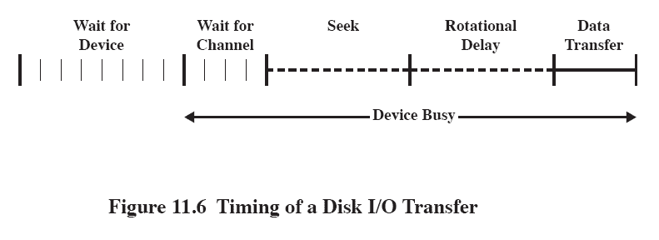
Disk Performance Parameters
The actual details of disk I/O operation depend on the:
computer system
operating system
nature of the I/O channel and disk controller hardware
Notes:
The actual details of disk I/O operation depend on the computer system, the operating
system, and the nature of the I/O channel and disk controller hardware. A
general timing diagram of disk I/O transfer is shown in Figure 11.6 .
‹#›

Slide 23
Positioning the Read/Write Heads
When the disk drive is operating, the disk is rotating at constant speed
To read or write the head must be positioned at the desired track and at the beginning of the desired sector on that track
Track selection involves moving the head in a movable-head system or electronically selecting one head on a fixed-head system
On a movable-head system the time it takes to position the head at the track is known as seek time
The time it takes for the beginning of the sector to reach the head is known as rotational delay
The sum of the seek time and the rotational delay equals the access time
Notes:
When the disk drive is operating, the disk is rotating at constant speed. To
read or write, the head must be positioned at the desired track and at the beginning
of the desired sector on that track. 1 Track selection involves moving the head in a
movable-head system or electronically selecting one head on a fixed-head system.
On a movable-head system, the time it takes to position the head at the track is
known as seek time . In either case, once the track is selected, the disk controller
waits until the appropriate sector rotates to line up with the head. The time it takes
for the beginning of the sector to reach the head is known as rotational delay , or
rotational latency. The sum of the seek time, if any, and the rotational delay equals
the access time , which is the time it takes to get into position to read or write. Once
the head is in position, the read or write operation is then performed as the sector
moves under the head; this is the data transfer portion of the operation; the time
required for the transfer is the transfer time .
In addition to the access time and transfer time, there are several queuing
delays normally associated with a disk I/O operation. When a process issues an
I/O request, it must first wait in a queue for the device to be available. At that
time, the device is assigned to the process. If the device shares a single I/O channel
or a set of I/O channels with other disk drives, then there may be an additional
wait for the channel to be available. At that point, the seek is performed to begin
disk access.
In some high-end systems for servers, a technique known as rotational
positional sensing (RPS) is used. This works as follows: When the seek command
has been issued, the channel is released to handle other I/O operations. When
the seek is completed, the device determines when the data will rotate under
the head. As that sector approaches the head, the device tries to reestablish the
communication path back to the host. If either the control unit or the channel is
busy with another I/O, then the reconnection attempt fails and the device must
rotate one whole revolution before it can attempt to reconnect, which is called
an RPS miss. This is an extra delay element that must be added to the time line
of Figure 11.6 .
‹#›

Slide 24
Starting at track 100
Next track accessed
55 , 58 ,39,18,90,160,150,38,184

Slide 25
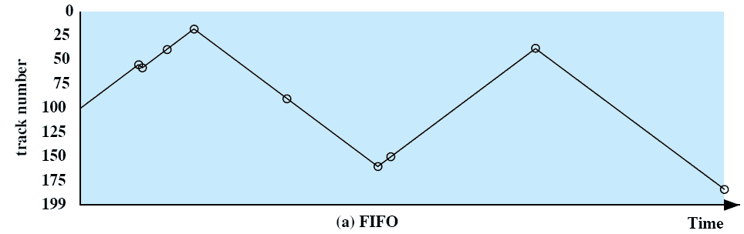
First-In, First-Out (FIFO)
Processes in sequential order
Fair to all processes
Approximates random scheduling in performance if there are many processes competing for the disk
Notes:
The simplest form of scheduling is first-in-first-out (FIFO)
scheduling, which processes items from the queue in sequential order. This strategy
has the advantage of being fair, because every request is honored and the requests are
honored in the order received. Figure 11.7a illustrates the disk arm movement with
FIFO. This graph is generated directly from the data in Table 11.2a . As can be seen,
the disk accesses are in the same order as the requests were originally received.
With FIFO, if there are only a few processes that require access and if many
of the requests are to clustered file sectors, then we can hope for good performance.
However, this technique will often approximate random scheduling in performance,
if there are many processes competing for the disk. Thus, it may be profitable to
consider a more sophisticated scheduling policy. A number of these are listed in
Table 11.3 and will now be considered.
‹#›

Slide 26
Priority (PRI)
Control of the scheduling is outside the control of disk management software
Goal is not to optimize disk utilization but to meet other objectives
Short batch jobs and interactive jobs are given higher priority
Provides good interactive response time
Longer jobs may have to wait an excessively long time
A poor policy for database systems
Notes:
With a system based on priority (PRI), the control of the scheduling is
outside the control of disk management software. Such an approach is not intended
to optimize disk utilization but to meet other objectives within the operating system.
Often short batch jobs and interactive jobs are given higher priority than longer jobs
that require longer computation. This allows a lot of short jobs to be flushed through
the system quickly and may provide good interactive response time. However, longer
jobs may have to wait excessively long times. Furthermore, such a policy could lead
to countermeasures on the part of users, who split their jobs into smaller pieces to
beat the system. This type of policy tends to be poor for database systems.
‹#›

Slide 27
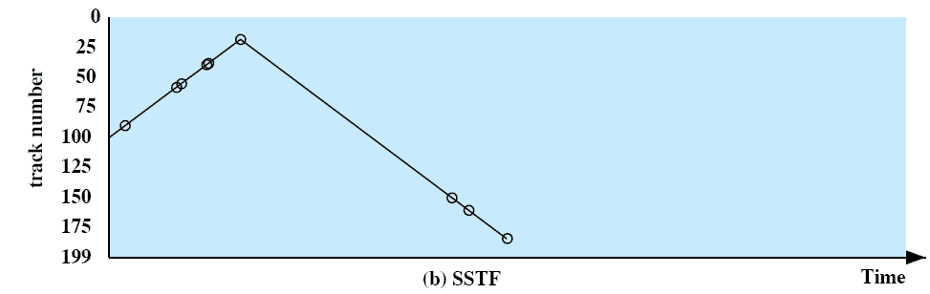
Shortest Service Time First (SSTF)
Select the disk I/O request that requires the least movement of the disk arm from its current position
Always choose the minimum seek time
Notes:
The shortest-service-time-first (SSTF) policy
is to select the disk I/O request that requires the least movement of the disk arm
from its current position. Thus, we always choose to incur the minimum seek time.
Of course, always choosing the minimum seek time does not guarantee that the
average seek time over a number of arm movements will be minimum. However,
this should provide better performance than FIFO. Because the arm can move in
two directions, a random tie-breaking algorithm may be used to resolve cases of
equal distances.
Figure 11.7b and Table 11.2b show the performance of SSTF on the same
example as was used for FIFO. The first track accessed is 90, because this is the
closest requested track to the starting position. The next track accessed is 58 because
this is the closest of the remaining requested tracks to the current position of 90.
Subsequent tracks are selected accordingly.
‹#›

Slide 28
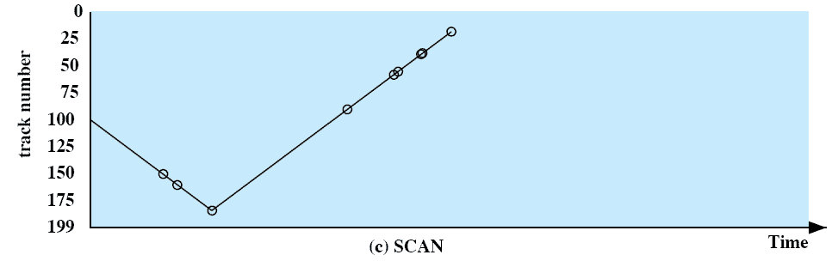
SCANand LOOK
Also known as the elevator algorithm
Arm moves in one direction only
satisfies all outstanding requests until it reaches the last track in that direction then the direction is reversed
Favors jobs whose requests are for tracks nearest to both innermost and outermost tracks
Notes:
With the exception of FIFO, all of the policies described so far can leave
some request unfulfilled until the entire queue is emptied. That is, there may always
be new requests arriving that will be chosen before an existing request. A simple
alternative that prevents this sort of starvation is the SCAN algorithm, also known
as the elevator algorithm because it operates much the way an elevator does.
With SCAN, the arm is required to move in one direction only, satisfying all
outstanding requests en route, until it reaches the last track in that direction or until
there are no more requests in that direction. This latter refinement is sometimes
referred to as the LOOK policy. The service direction is then reversed and the scan
proceeds in the opposite direction, again picking up all requests in order.
Figure 11.7c and Table 11.2c illustrate the SCAN policy. Assuming that the
initial direction is of increasing track number, then the first track selected is 150,
since this is the closest track to the starting track of 100 in the increasing direction.
As can be seen, the SCAN policy behaves almost identically with the SSTF
policy. Indeed, if we had assumed that the arm was moving in the direction of lower
track numbers at the beginning of the example, then the scheduling pattern would
have been identical for SSTF and SCAN. However, this is a static example in which
no new items are added to the queue. Even when the queue is dynamically changing,
SCAN will be similar to SSTF unless the request pattern is unusual.
Note that the SCAN policy is biased against the area most recently traversed.
Thus it does not exploit locality as well as SSTF.
It is not difficult to see that the SCAN policy favors jobs whose requests are
for tracks nearest to both innermost and outermost tracks and favors the latest arriving
jobs. The first problem can be avoided via the C-SCAN policy, while the
second problem is addressed by the N-step-SCAN policy.
‹#›

Slide 29
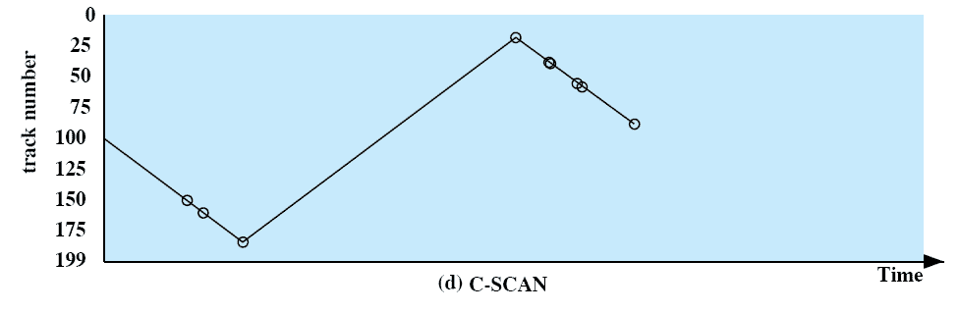
C-SCAN C-Look (Circular SCAN)
Restricts scanning to one direction only
When the last track has been visited in one direction, the arm is returned to the opposite end of the disk and the scan begins again
Notes:
The C-SCAN (circular SCAN) policy restricts scanning to one direction
only. Thus, when the last track has been visited in one direction, the arm is returned
to the opposite end of the disk and the scan begins again. This reduces the maximum
delay experienced by new requests. With SCAN, if the expected time for a scan
from inner track to outer track is t , then the expected service interval for sectors at
the periphery is 2 t. With C-SCAN, the interval is on the order of t + s max , where
s max is the maximum seek time.
Figure 11.7d and Table 11.2d illustrate C-SCAN behavior. In this case the first
three requested tracks encountered are 150, 160, and 184. Then the scan begins
starting at the lowest track number, and the next requested track encountered is 18.
‹#›

Slide 30
Starting at track 100 Next track accessed
55 , 58 ,39,18,90,160,150,38,184

Slide 31
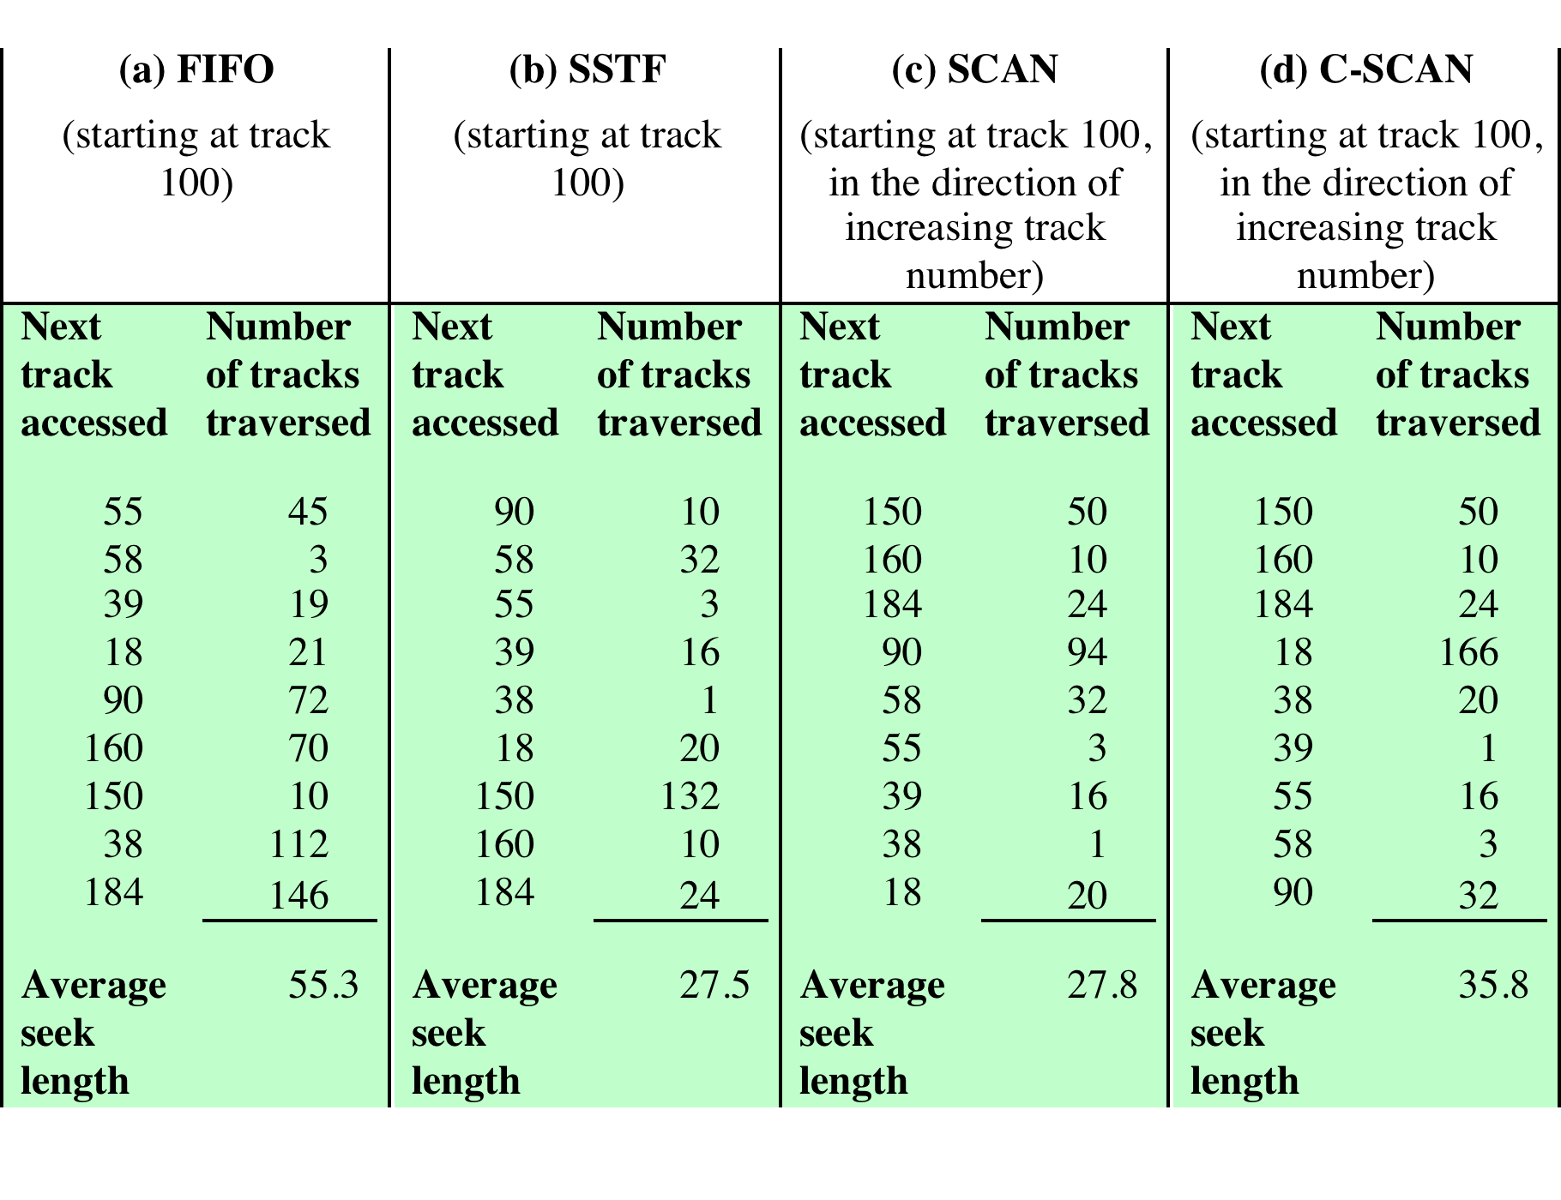
Table 11.2 Comparison of Disk Scheduling Algorithms
Notes:
Table 11.2 Comparison of Disk Scheduling Algorithms
‹#›

Slide 32
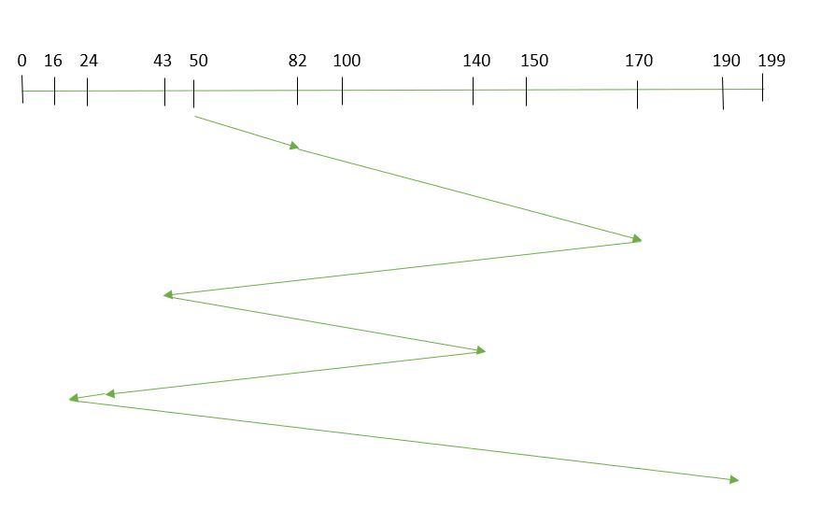
Suppose the order of request is- (82,170,43,140,24,16,190) And current position of Read/Write head is : 50
FCFS

Slide 33
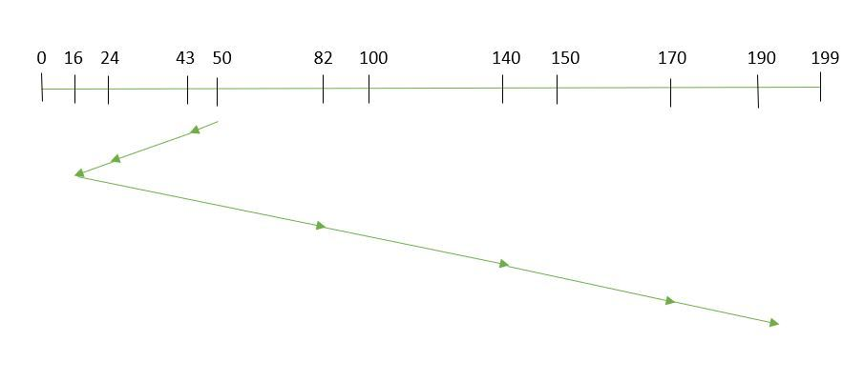
SSTF

Slide 34
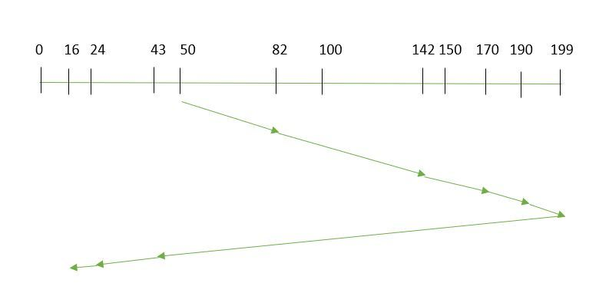
SCAN

Slide 35
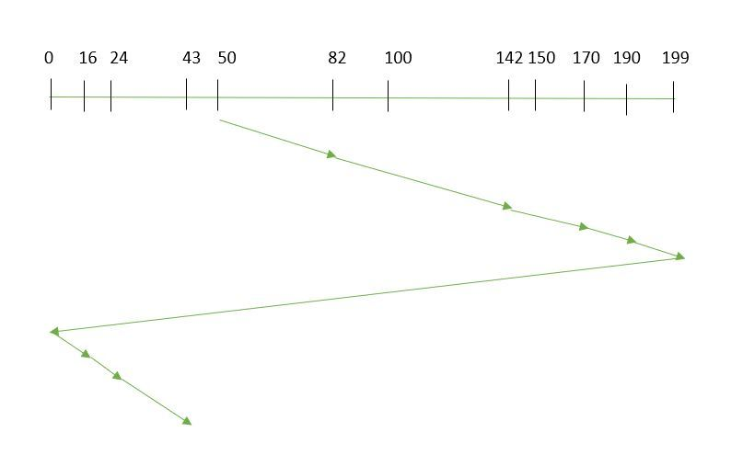
C-SCAN

Slide 36
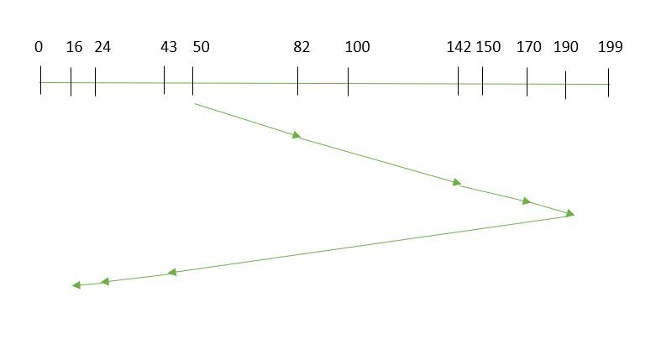
LOOK

Slide 37
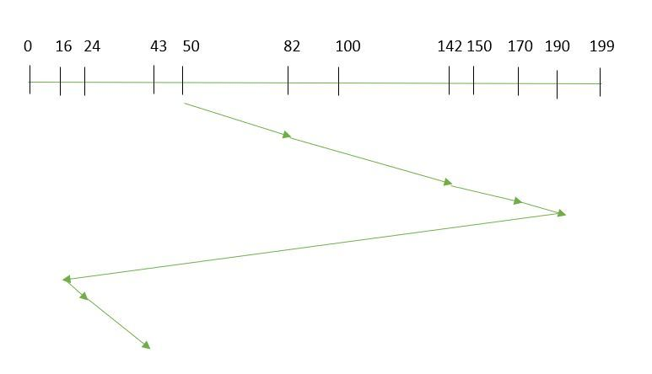
C- LOOK

Slide 38
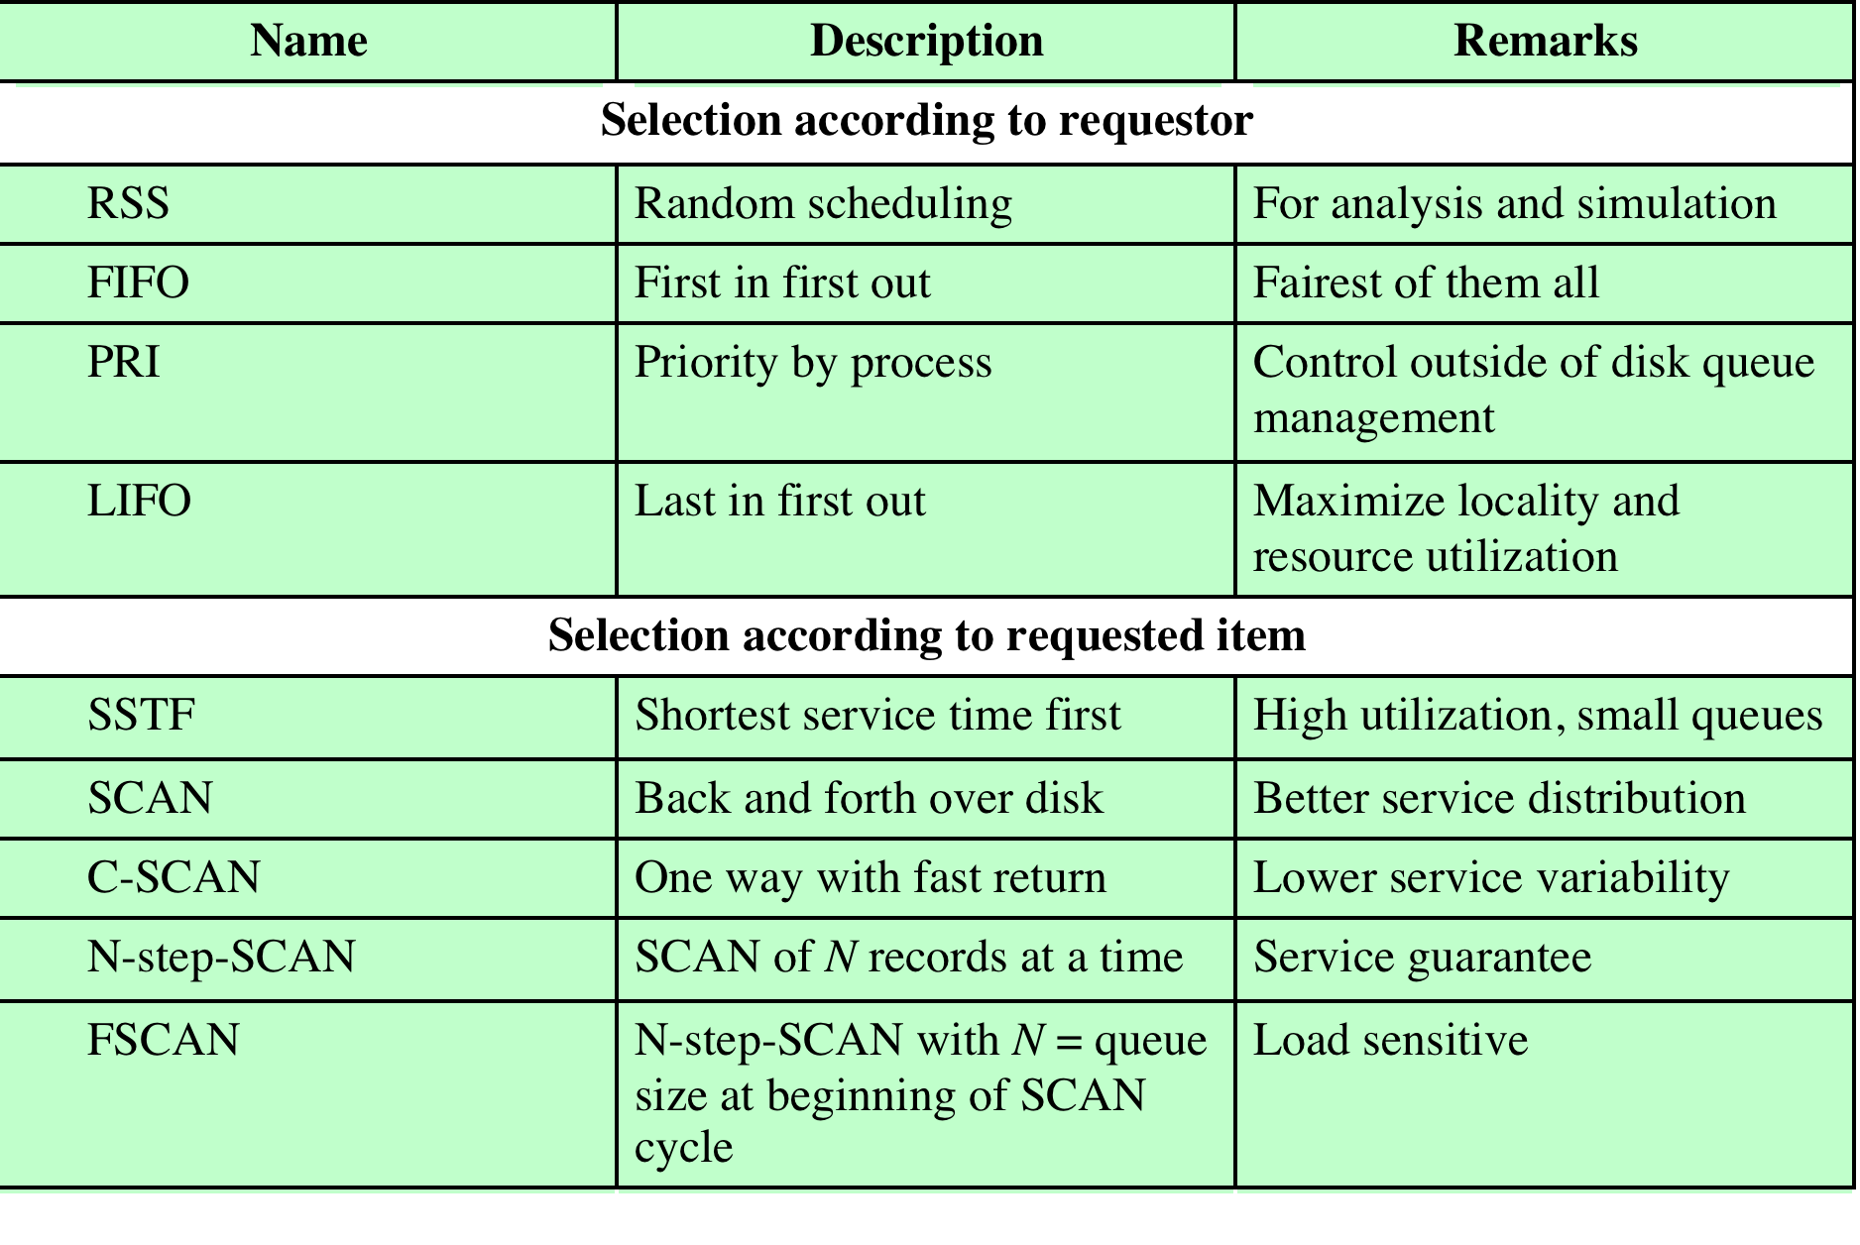
Table 11.3 Disk Scheduling Algorithms
Notes:
Table 11.3 Disk Scheduling Algorithms
‹#›

Slide 39
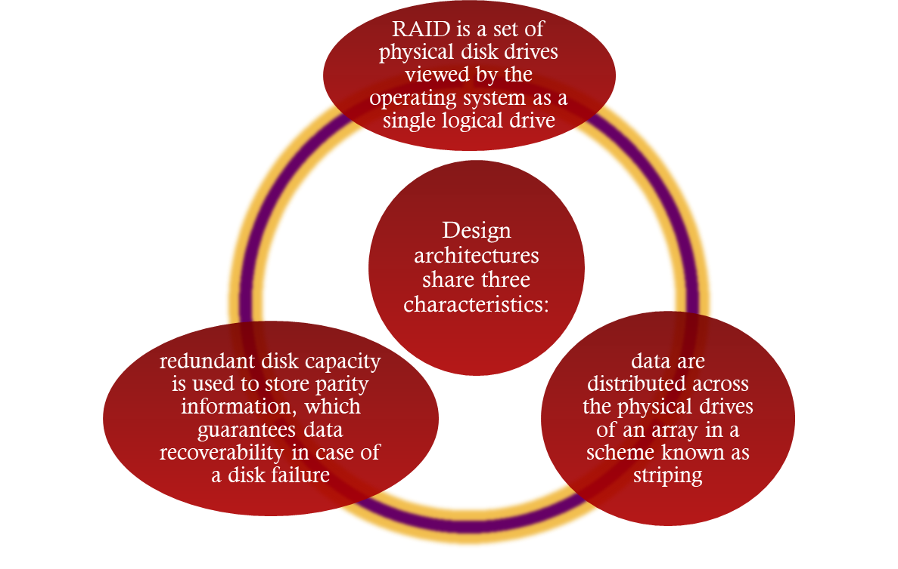
RAID
Redundant Array of Independent Disks
Consists of seven levels, zero through six
Notes:
With the use of multiple disks, there is a wide variety of ways in which the data
can be organized and in which redundancy can be added to improve reliability. This
could make it difficult to develop database schemes that are usable on a number of
platforms and operating systems. Fortunately, industry has agreed on a standardized
scheme for multiple-disk database design, known as RAID (redundant array of
independent disks). The RAID scheme consists of seven levels, 2 zero through six.
These levels do not imply a hierarchical relationship but designate different design
architectures that share three common characteristics:
1. RAID is a set of physical disk drives viewed by the operating system as a single
logical drive.
2. Data are distributed across the physical drives of an array in a scheme known
as striping, described subsequently.
3. Redundant disk capacity is used to store parity information, which guarantees
data recoverability in case of a disk failure.
‹#›

Slide 40
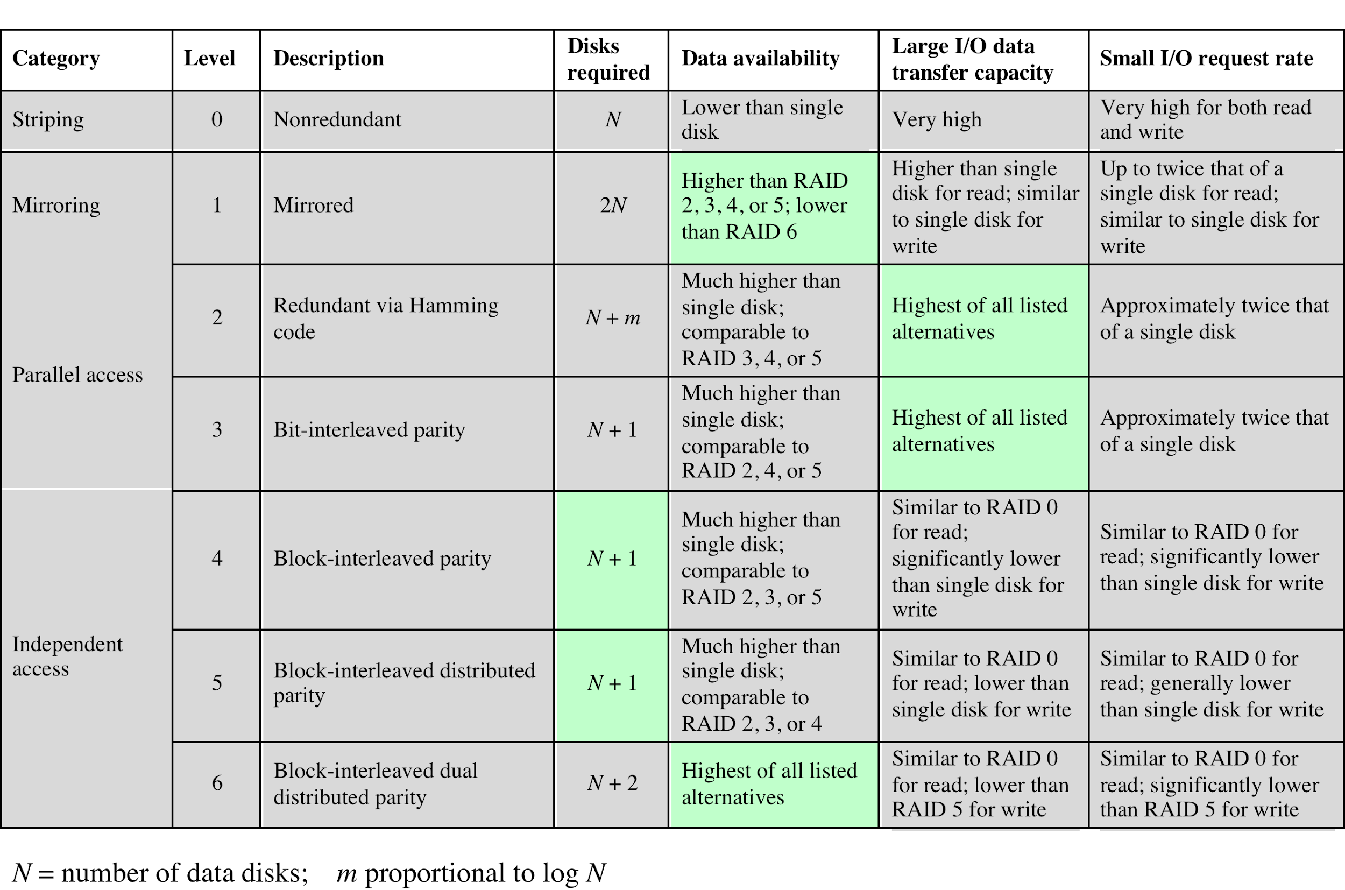
Table 11.4 RAID Levels
Notes:
We now examine each of the RAID levels. Table 11.4 provides a rough
guide to the seven levels. In the table, I/O performance is shown both in terms of
data transfer capacity, or ability to move data, and I/O request rate, or ability to
satisfy I/O requests, since these RAID levels inherently perform differently relative
to these two metrics. Each RAID level’s strong point is highlighted in color.
Of the seven RAID levels described, only four are commonly used: RAID
levels 0, 1, 5, and 6.
‹#›

Slide 41
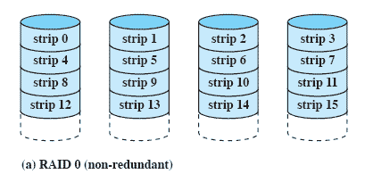
RAID Level 0
Not a true RAID because it does not include redundancy to improve performance or provide data protection
User and system data are distributed across all of the disks in the array
Logical disk is divided into strips
Notes:
RAID level 0 is not a true member of the RAID family, because it does not include
redundancy to improve performance or provide data protection. However, there
are a few applications, such as some on supercomputers in which performance
and capacity are primary concerns and low cost is more important than improved
reliability.
For RAID 0, the user and system data are distributed across all of the disks
in the array. This has a notable advantage over the use of a single large disk: If two
different I/O requests are pending for two different blocks of data, then there is a
good chance that the requested blocks are on different disks. Thus, the two requests
can be issued in parallel, reducing the I/O queuing time.
But RAID 0, as with all of the RAID levels, goes further than simply distributing
the data across a disk array: The data are striped across the available disks.
This is best understood by considering Figure 11.8 . All user and system data are
viewed as being stored on a logical disk. The logical disk is divided into strips; these
strips may be physical blocks, sectors, or some other unit. The strips are mapped
round robin to consecutive physical disks in the RAID array. A set of logically
consecutive strips that maps exactly one strip to each array member is referred
to as a stripe . In an n -disk array, the first n logical strips are physically stored as
the first strip on each of the n disks, forming the first stripe; the second n strips
are distributed as the second strips on each disk; and so on. The advantage of this
layout is that if a single I/O request consists of multiple logically contiguous strips,
then up to n strips for that request can be handled in parallel, greatly reducing the
I/O transfer time.
‹#›

Slide 42
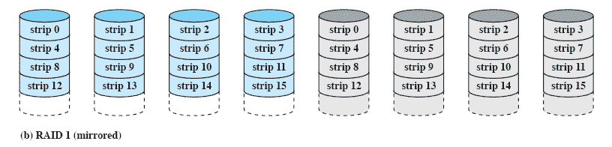
RAID Level 1
Redundancy is achieved by the simple expedient of duplicating all the data
There is no “write penalty”
When a drive fails the data may still be accessed from the second drive
Principal disadvantage is the cost
Notes:
RAID 1 differs from RAID levels 2 through 6 in the way in which redundancy is
achieved. In these other RAID schemes, some form of parity calculation is used
to introduce redundancy, whereas in RAID 1, redundancy is achieved by the simple
expedient of duplicating all the data. Figure 11.8b shows data striping being
used, as in RAID 0. But in this case, each logical strip is mapped to two separate
physical disks so that every disk in the array has a mirror disk that contains the
same data. RAID 1 can also be implemented without data striping, though this is
less common.
There are a number of positive aspects to the RAID 1 organization:
1. A read request can be serviced by either of the two disks that contains the
requested data, whichever one involves the minimum seek time plus rotational
latency.
2. A write request requires that both corresponding strips be updated, but this
can be done in parallel. Thus, the write performance is dictated by the slower
of the two writes (i.e., the one that involves the larger seek time plus rotational
latency). However, there is no “write penalty” with RAID 1. RAID levels
2 through 6 involve the use of parity bits. Therefore, when a single strip is
updated, the array management software must first compute and update the
parity bits as well as updating the actual strip in question.
3. Recovery from a failure is simple. When a drive fails, the data may still be
accessed from the second drive.
The principal disadvantage of RAID 1 is the cost; it requires twice the disk
space of the logical disk that it supports. Because of that, a RAID 1 configuration
is likely to be limited to drives that store system software and data and other highly
critical files. In these cases, RAID 1 provides real-time backup of all data so that in
the event of a disk failure, all of the critical data is still immediately available.
In a transaction-oriented environment, RAID 1 can achieve high I/O request
rates if the bulk of the requests are reads. In this situation, the performance of RAID
1 can approach double of that of RAID 0. However, if a substantial fraction of the I/O
requests are write requests, then there may be no significant performance gain over
RAID 0. RAID 1 may also provide improved performance over RAID 0 for data
transfer intensive applications with a high percentage of reads. Improvement occurs
if the application can split each read request so that both disk members participate.
‹#›

Slide 43
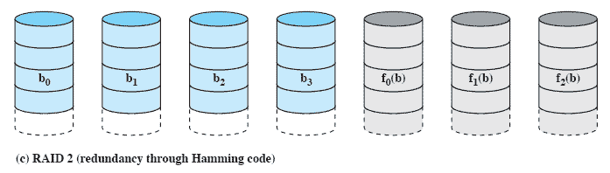
RAID Level 2
Makes use of a parallel access technique
Data striping is used
Typically a Hamming code is used
Effective choice in an environment in which many disk errors occur
Notes:
RAID levels 2 and 3 make use of a parallel access technique. In a parallel access
array, all member disks participate in the execution of every I/O request. Typically,
the spindles of the individual drives are synchronized so that each disk head is in the
same position on each disk at any given time.
As in the other RAID schemes, data striping is used. In the case of RAID 2
and 3, the strips are very small, often as small as a single byte or word. With RAID 2,
an error-correcting code is calculated across corresponding bits on each data disk,
and the bits of the code are stored in the corresponding bit positions on multiple
parity disks. Typically, a Hamming code is used, which is able to correct single-bit
errors and detect double-bit errors.
Although RAID 2 requires fewer disks than RAID 1, it is still rather costly.
The number of redundant disks is proportional to the log of the number of data
disks. On a single read, all disks are simultaneously accessed. The requested data
and the associated error-correcting code are delivered to the array controller. If
there is a single-bit error, the controller can recognize and correct the error instantly,
so that the read access time is not slowed. On a single write, all data disks and parity
disks must be accessed for the write operation.
RAID 2 would only be an effective choice in an environment in which many
disk errors occur. Given the high reliability of individual disks and disk drives,
RAID 2 is overkill and is not implemented.
‹#›

Slide 44
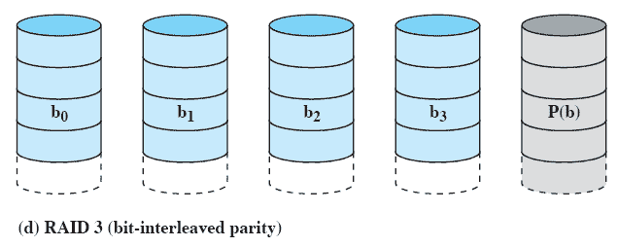
RAID Level 3
Requires only a single redundant disk, no matter how large the disk array
Employs parallel access, with data distributed in small strips
Can achieve very high data transfer rates
Notes:
RAID 3 is organized in a similar fashion to RAID 2. The difference is that RAID 3
requires only a single redundant disk, no matter how large the disk array. RAID 3
employs parallel access, with data distributed in small strips. Instead of an error correcting
code, a simple parity bit is computed for the set of individual bits in the
same position on all of the data disks.
REDUNDANCY In the event of a drive failure, the parity drive is accessed and data
is reconstructed from the remaining devices. Once the failed drive is replaced, the
missing data can be restored on the new drive and operation resumed.
Data reconstruction is simple. Consider an array of five drives in which X0
through X3 contain data and X4 is the parity disk. The parity for the i th bit is
calculated as follows:
X4(i) = X3(i) X2(i) X1(i) X0(i)
where is exclusive-OR function.
Suppose that drive X1 has failed. If we add X4(i) X1(i) to both sides of the
preceding equation, we get
X1(i) = X4(i) X3(i) X2(i) X0(i)
Thus, the contents of each strip of data on X1 can be regenerated from the contents
of the corresponding strips on the remaining disks in the array. This principle is true
for RAID levels 3 through 6.
In the event of a disk failure, all of the data are still available in what is referred
to as reduced mode. In this mode, for reads, the missing data are regenerated on the
fly using the exclusive-OR calculation. When data are written to a reduced RAID 3
array, consistency of the parity must be maintained for later regeneration. Return to
full operation requires that the failed disk be replaced and the entire contents of the
failed disk be regenerated on the new disk.
PERFORMANCE Because data are striped in very small strips, RAID 3 can achieve
very high data transfer rates. Any I/O request will involve the parallel transfer of
data from all of the data disks. For large transfers, the performance improvement is
especially noticeable. On the other hand, only one I/O request can be executed at a
time. Thus, in a transaction-oriented environment, performance suffers.
‹#›

Slide 45
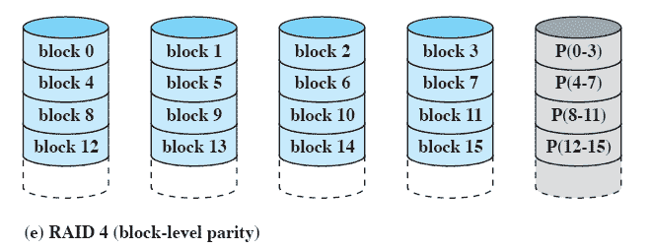
RAID Level 4
Makes use of an independent access technique
A bit-by-bit parity strip is calculated across corresponding strips on each data disk, and the parity bits are stored in the corresponding strip on the parity disk
Involves a write penalty when an I/O write request of small size is performed
Notes:
RAID levels 4 through 6 make use of an independent access technique. In an independent
access array, each member disk operates independently, so that separate
I/O requests can be satisfied in parallel. Because of this, independent access arrays
are more suitable for applications that require high I/O request rates and are relatively
less suited for applications that require high data transfer rates.
As in the other RAID schemes, data striping is used. In the case of RAID
4 through 6, the strips are relatively large. With RAID 4, a bit-by-bit parity strip
is calculated across corresponding strips on each data disk, and the parity bits are
stored in the corresponding strip on the parity disk.
RAID 4 involves a write penalty when an I/O write request of small size is performed.
Each time that a write occurs, the array management software must update
not only the user data but also the corresponding parity bits. Consider an array of
five drives in which X0 through X3 contain data and X4 is the parity disk. Suppose
that a write is performed that only involves a strip on disk X1. Initially, for each bit
i , we have the following relationship:
X4(i) = X3(i) X2(i) X1(i) X0(i) (11.1)
After the update, with potentially altered bits indicated by a prime symbol:
X4=(i) = X3(i) X2(i) X1=(i) X0(i)
= X3(i) X2(i) X1=(i) X0(i) X1(i) X1(i)
= X3(i) X2(i) X1 (i) X0(i) X1(i) X1=(i)
= X4(i) X1(i) X1=(i)
The preceding set of equations is derived as follows. The first line shows that
a change in X1 will also affect the parity disk X4. In the second line, we add the
terms [ X1(i) X1(i)] . Because the exclusive-OR of any quantity with itself
is 0, this does not affect the equation. However, it is a convenience that is used to
create the third line, by reordering. Finally, Equation ( 11.1 ) is used to replace the
first four terms by X4( i ).
To calculate the new parity, the array management software must read the old
user strip and the old parity strip. Then it can update these two strips with the new
data and the newly calculated parity. Thus, each strip write involves two reads and
two writes.
In the case of a larger size I/O write that involves strips on all disk drives, parity
is easily computed by calculation using only the new data bits. Thus, the parity drive
can be updated in parallel with the data drives and there are no extra reads or writes.
In any case, every write operation must involve the parity disk, which therefore
can become a bottleneck.
‹#›

Slide 46
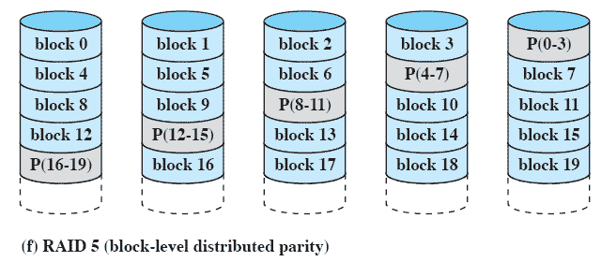
RAID Level 5
Similar to RAID-4 but distributes the parity bits across all disks
Typical allocation is a round-robin scheme
Has the characteristic that the loss of any one disk does not result in data loss
Notes:
RAID 5 is organized in a similar fashion to RAID 4. The difference is that RAID
5 distributes the parity strips across all disks. A typical allocation is a round-robin
scheme, as illustrated in Figure 11.8f . For an n -disk array, the parity strip is on a
different disk for the first n stripes, and the pattern then repeats.
The distribution of parity strips across all drives avoids the potential I/O
bottleneck of the single parity disk found in RAID 4. Further, RAID 5 has the
characteristic that the loss of any one disk does not result in data loss.
‹#›

Slide 47
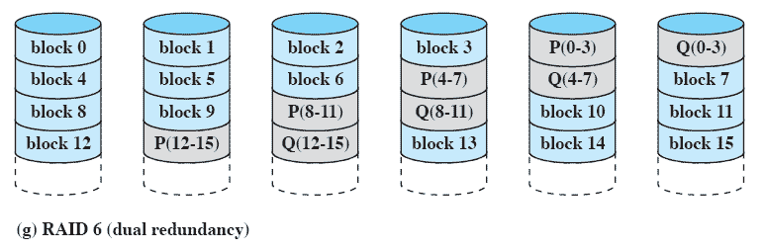
RAID Level 6
Two different parity calculations are carried out and stored in separate blocks on different disks
Provides extremely high data availability
Incurs a substantial write penalty because each write affects two parity blocks
Notes:
RAID 6 was introduced in a subsequent paper by the Berkeley researchers
[KATZ89]. In the RAID 6 scheme, two different parity calculations are carried out
and stored in separate blocks on different disks. Thus, a RAID 6 array whose user
data require N disks consists of N + 2 disks.
Figure 11.8g illustrates the scheme. P and Q are two different data check algorithms.
One of the two is the exclusive-OR calculation used in RAID 4 and 5. But
the other is an independent data check algorithm. This makes it possible to regenerate
data even if two disks containing user data fail.
The advantage of RAID 6 is that it provides extremely high data availability.
Three disks would have to fail within the MTTR (mean time to repair) interval to
cause data to be lost. On the other hand, RAID 6 incurs a substantial write penalty,
because each write affects two parity blocks. Performance benchmarks [EISC07]
show a RAID 6 controller can suffer more than a 30% drop in overall write performance
compared with a RAID 5 implementation. RAID 5 and RAID 6 read
performance is comparable.
‹#›

Slide 48
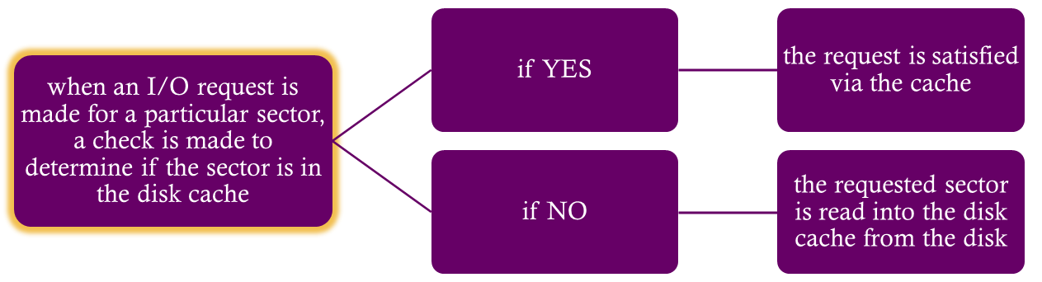
Disk Cache
Cache memory is used to apply to a memory that is smaller and faster than main memory and that is interposed between main memory and the processor
Reduces average memory access time by exploiting the principle of locality
Disk cache is a buffer in main memory for disk sectors
Contains a copy of some of the sectors on the disk
Notes:
In Section 1.6 and Appendix 1A, we summarized the principles of cache memory.
The term cache memory is usually used to apply to a memory that is smaller and
faster than main memory and that is interposed between main memory and the
processor. Such a cache memory reduces average memory access time by exploiting
the principle of locality.
The same principle can be applied to disk memory. Specifically, a disk cache
is a buffer in main memory for disk sectors. The cache contains a copy of some of
the sectors on the disk. When an I/O request is made for a particular sector, a check
is made to determine if the sector is in the disk cache. If so, the request is satisfied
via the cache. If not, the requested sector is read into the disk cache from the disk.
Because of the phenomenon of locality of reference, when a block of data is fetched
into the cache to satisfy a single I/O request, it is likely that there will be future
references to that same block.
‹#›

Slide 49

Least Recently Used (LRU)
Most commonly used algorithm that deals with the design issue of replacement strategy
The block that has been in the cache the longest with no reference to it is replaced
A stack of pointers reference the cache
most recently referenced block is on the top of the stack
when a block is referenced or brought into the cache, it is placed on the top of the stack
Notes:
The most commonly used algorithm is least recently used (LRU)
Replace that block that has been in the cache longest with no reference to it.
The cache consists of a stack of blocks, with the most recently referenced block on the top of the stack.
When a block in the cache is referenced, it is moved from its existing position on the stack to the top of the stack.
When a block is brought in from secondary memory, remove the block that is on the bottom of the stack and push the incoming block onto the top of the stack.
It is not necessary actually to move these blocks around in main memory; a stack of pointers can be associated with the cache.
‹#›

Slide 50

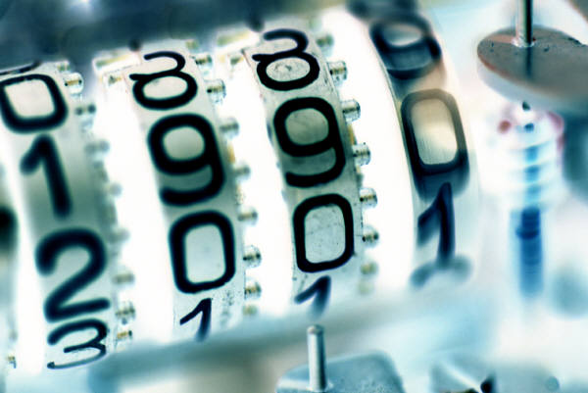
Least Frequently Used (LFU)
The block that has experienced the fewest references is replaced
A counter is associated with each block
Counter is incremented each time block is accessed
When replacement is required, the block with the smallest count is selected
Notes:
Another possibility is least frequently used (LFU) : Replace that block in the
set that has experienced the fewest references. LFU could be implemented by associating
a counter with each block. When a block is brought in, it is assigned a count
of 1; with each reference to the block, its count is incremented by 1. When replacement
is required, the block with the smallest count is selected. Intuitively, it might
seem that LFU is more appropriate than LRU because LFU makes use of more
pertinent information about each block in the selection process.
A simple LFU algorithm has the following problem. It may be that certain
blocks are referenced relatively infrequently overall, but when they are referenced,
there are short intervals of repeated references due to locality, thus building up
high reference counts. After such an interval is over, the reference count may be
misleading and not reflect the probability that the block will soon be referenced
again. Thus, the effect of locality may actually cause the LFU algorithm to make
poor replacement choices.
‹#›

Slide 51
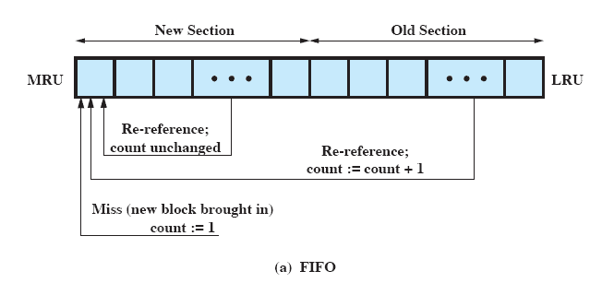
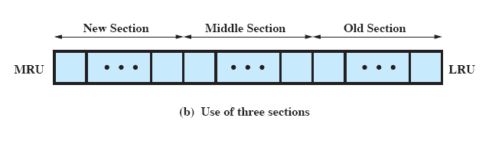
Frequency-Based Replacement
Notes:
To overcome this difficulty with LFU, a technique known as frequency-based
replacement is proposed in [ROBI90]. For clarity, let us first consider a simplified
version, illustrated in Figure 11.9a . The blocks are logically organized in a stack, as
with the LRU algorithm. A certain portion of the top part of the stack is designated
the new section. When there is a cache hit, the referenced block is moved to the top
of the stack. If the block was already in the new section, its reference count is not
incremented; otherwise it is incremented by 1. Given a sufficiently large new section,
this results in the reference counts for blocks that are repeatedly re-referenced
within a short interval remaining unchanged. On a miss, the block with the smallest
reference count that is not in the new section is chosen for replacement; the least
recently used such block is chosen in the event of a tie.
The authors report that this strategy achieved only slight improvement over
LRU. The problem is the following:
1. On a cache miss, a new block is brought into the new section, with a count of 1.
2. The count remains at 1 as long as the block remains in the new section.
3. Eventually the block ages out of the new section, with its count still at 1.
4. If the block is not now re-referenced fairly quickly, it is very likely to be
replaced because it necessarily has the smallest reference count of those blocks
that are not in the new section. In other words, there does not seem to be a
sufficiently long interval for blocks aging out of the new section to build up
their reference counts even if they were relatively frequently referenced.
A further refinement addresses this problem: Divide the stack into three
sections: new, middle, and old ( Figure 11.9b ). As before, reference counts are not
incremented on blocks in the new section. However, only blocks in the old section
are eligible for replacement. Assuming a sufficiently large middle section, this allows
relatively frequently referenced blocks a chance to build up their reference counts
before becoming eligible for replacement. Simulation studies by the authors indicate
that this refined policy is significantly better than simple LRU or LFU.
Regardless of the particular replacement strategy, the replacement can take
place on demand or preplanned. In the former case, a sector is replaced only when
the slot is needed. In the latter case, a number of slots are released at a time. The
reason for this latter approach is related to the need to write back sectors. If a sector
is brought into the cache and only read, then when it is replaced, it is not necessary
to write it back out to the disk. However, if the sector has been updated, then it is
necessary to write it back out before replacing it. In this latter case, it makes sense
to cluster the writing and to order the writing to minimize seek time.
‹#›

Slide 52
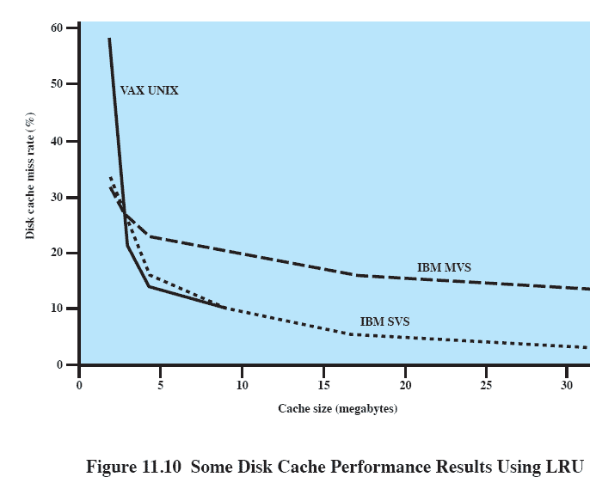
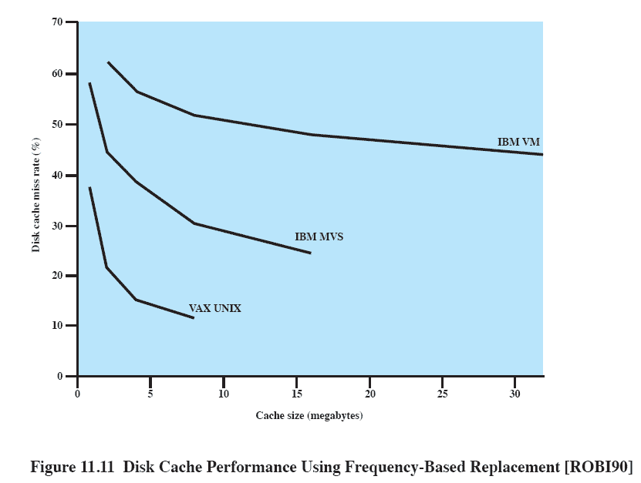
Disk Cache Performance
Frequency-Based
Replacement
LRU
Notes:
The same performance considerations discussed in Appendix 1A apply here. The
issue of cache performance reduces itself to a question of whether a given miss ratio
can be achieved. This will depend on the locality behavior of the disk references,
the replacement algorithm, and other design factors. Principally, however, the miss
ratio is a function of the size of the disk cache. Figure 11.10 summarizes results from
several studies using LRU, one for a UNIX system running on a VAX [OUST85]
and one for IBM mainframe operating systems [SMIT85]. Figure 11.11 shows results
for simulation studies of the frequency-based replacement algorithm. A comparison
of the two figures points out one of the risks of this sort of performance assessment.
The figures appear to show that LRU outperforms the frequency-based replacement
algorithm. However, when identical reference patterns using the same cache
structure are compared, the frequency-based replacement algorithm is superior.
Thus, the exact sequence of reference patterns, plus related design issues such as
block size, will have a profound influence on the performance achieved.
‹#›

Slide 53
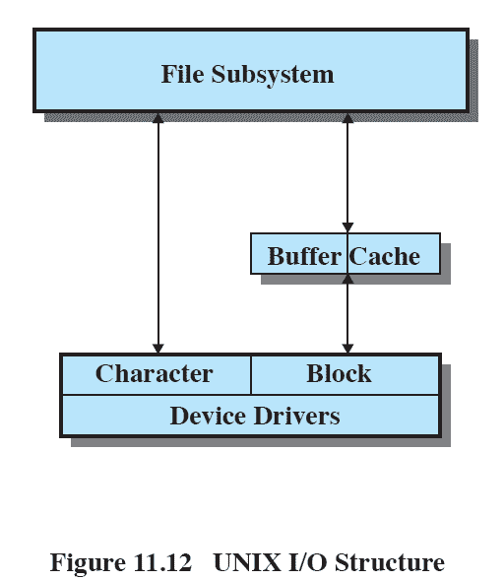
UNIX SVR4 I/O
Two types of I/O
Buffered
system buffer caches
character queues
Unbuffered
Notes:
In UNIX, each individual I/O device is associated with a special file. These are managed
by the file system and are read and written in the same manner as user data
files. This provides a clean, uniform interface to users and processes. To read from
or write to a device, read and write requests are made for the special file associated
with the device.
Figure 11.12 illustrates the logical structure of the I/O facility. The file subsystem
manages files on secondary storage devices. In addition, it serves as the process
interface to devices, because these are treated as files.
There are two types of I/O in UNIX: buffered and unbuffered. Buffered I/O
passes through system buffers, whereas unbuffered I/O typically involves the DMA
facility, with the transfer taking place directly between the I/O module and the
process I/O area. For buffered I/O, two types of buffers are used: system buffer
caches and character queues.
‹#›

Slide 54
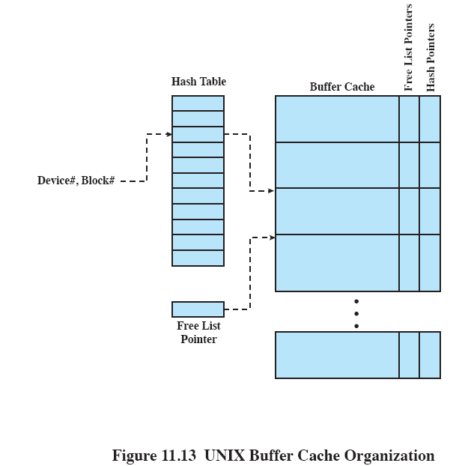
Buffer Cache
Three lists are maintained:
free list
device list
driver I/O queue
Notes:
The buffer cache in UNIX is essentially a disk cache. I/O operations with disk are
handled through the buffer cache. The data transfer between the buffer cache and
the user process space always occurs using DMA. Because both the buffer cache
and the process I/O area are in main memory, the DMA facility is used in this case
to perform a memory-to-memory copy. This does not use up any processor cycles,
but it does consume bus cycles.
To manage the buffer cache, three lists are maintained:
• Free list: List of all slots in the cache (a slot is referred to as a buffer in UNIX;
each slot holds one disk sector) that are available for allocation
• Device list: List of all buffers currently associated with each disk
• Driver I/O queue: List of buffers that are actually undergoing or waiting for
I/O on a particular device
All buffers should be on the free list or on the driver I/O queue list. A buffer,
once associated with a device, remains associated with the device even if it is on the
free list, until is actually reused and becomes associated with another device. These
lists are maintained as pointers associated with each buffer rather than physically
separate lists.
When a reference is made to a physical block number on a particular device, the
OS first checks to see if the block is in the buffer cache. To minimize the search time,
the device list is organized as a hash table, using a technique similar to the overflow
with chaining technique discussed in Appendix F (Figure F.1b). Figure 11.13 depicts
the general organization of the buffer cache. There is a hash table of fixed length
that contains pointers into the buffer cache. Each reference to a (device#, block#)
maps into a particular entry in the hash table. The pointer in that entry points to
the first buffer in the chain. A hash pointer associated with each buffer points to
the next buffer in the chain for that hash table entry. Thus, for all (device#, block#)
references that map into the same hash table entry, if the corresponding block is in
the buffer cache, then that buffer will be in the chain for that hash table entry. Thus,
the length of the search of the buffer cache is reduced by a factor on the order of N ,
where N is the length of the hash table.
For block replacement, a least-recently-used algorithm is used: After a buffer has
been allocated to a disk block, it cannot be used for another block until all other buffers
have been used more recently. The free list preserves this least-recently-used order.
‹#›

Slide 55
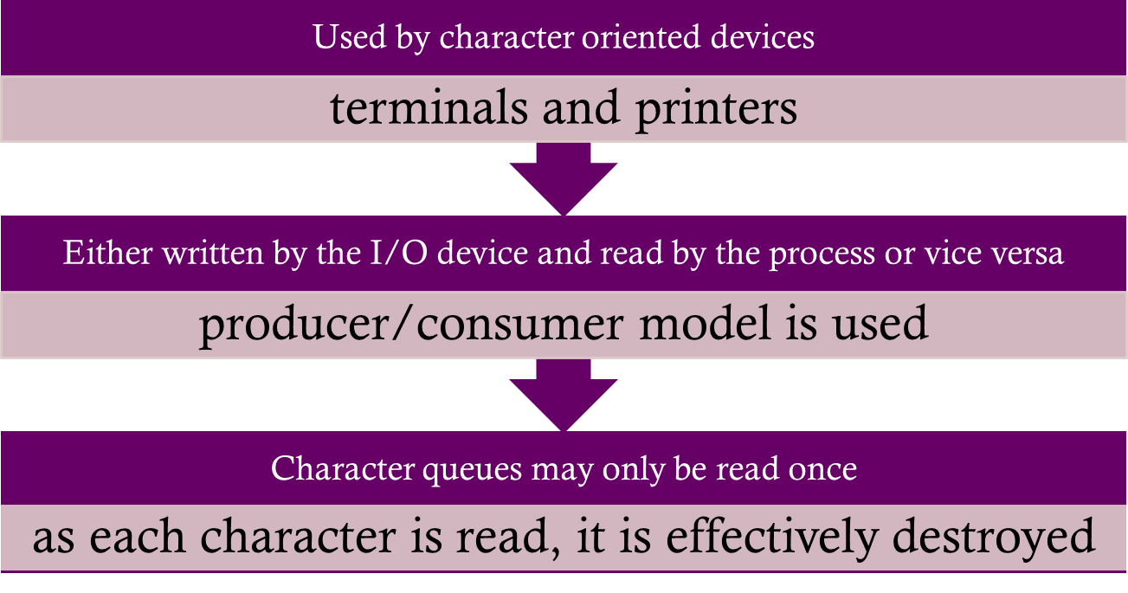
Character Queue
Notes:
Block-oriented devices, such as disk and USB keys, can be effectively served by the
buffer cache. A different form of buffering is appropriate for character-oriented
devices, such as terminals and printers. A character queue is either written by the
I/O device and read by the process or written by the process and read by the device.
In both cases, the producer/consumer model introduced in Chapter 5 is used. Thus,
character queues may only be read once; as each character is read, it is effectively
destroyed. This is in contrast to the buffer cache, which may be read multiple times
and hence follows the readers/writers model (also discussed in Chapter 5 ).
‹#›

Slide 56

Unbuffered I/O
Is simply DMA between device and process space
Is always the fastest method for a process to perform I/O
Process is locked in main memory and cannot be swapped out
I/O device is tied up with the process for the duration of the transfer making it unavailable for other processes
Notes:
Unbuffered I/O, which is simply DMA between device and process space,
is always the fastest method for a process to perform I/O. A process that is
performing unbuffered I/O is locked in main memory and cannot be swapped
out. This reduces the opportunities for swapping by tying up part of main memory,
thus reducing the overall system performance. Also, the I/O device is tied up
with the process for the duration of the transfer, making it unavailable for other
processes.
‹#›

Slide 57
Summary
I/O architecture is the computer system’s interface to the outside world
I/O functions are generally broken up into a number of layers
A key aspect of I/O is the use of buffers that are controlled by I/O utilities rather than by application processes
Buffering smoothes out the differences between the speeds
The use of buffers also decouples the actual I/O transfer from the address space of the application process
Disk I/O has the greatest impact on overall system performance
Two of the most widely used approaches are disk scheduling and the disk cache
A disk cache is a buffer, usually kept in main memory, that functions as a cache of disk block between disk memory and the rest of main memory
Notes:
The computer system’s interface to the outside world is its I/O architecture. This
architecture is designed to provide a systematic means of controlling interaction
with the outside world and to provide the operating system with the information it
needs to manage I/O activity effectively.
The I/O function is generally broken up into a number of layers, with lower
layers dealing with details that are closer to the physical functions to be performed
and higher layers dealing with I/O in a logical and generic fashion. The result is that
changes in hardware parameters need not affect most of the I/O software.
A key aspect of I/O is the use of buffers that are controlled by I/O utilities
rather than by application processes. Buffering smoothes out the differences
between the internal speeds of the computer system and the speeds of I/O devices.
The use of buffers also decouples the actual I/O transfer from the address space
of the application process. This allows the operating system more flexibility in
performing its memory-management function.
The aspect of I/O that has the greatest impact on overall system performance
is disk I/O. Accordingly, there has been greater research and design effort in this
area than in any other kind of I/O. Two of the most widely used approaches to
improve disk I/O performance are disk scheduling and the disk cache.
At any time, there may be a queue of requests for I/O on the same disk. It is
the object of disk scheduling to satisfy these requests in a way that minimizes the
mechanical seek time of the disk and hence improves performance. The physical
layout of pending requests plus considerations of locality come into play.
A disk cache is a buffer, usually kept in main memory, that functions as a
cache of disk blocks between disk memory and the rest of main memory. Because
of the principle of locality, the use of a disk cache should substantially reduce the
number of block I/O transfers between main memory and disk.
‹#›

